Slide 2
no
Chlorophyta & other Archaeplastida | Archaeplastida.Chlorophyta
Chlorophyta & other Archaeplastida | Archaeplastida.otherArchaeplastida
Cryptophyte | Cryptophyceae.Cryptomonadales.Geminigera
Cryptophyte | Cryptophyceae.otherCryptophyceae
Jakobida | Excavata.Discoba.Jakobida
Haptophyte | Haptophyta.Phaeocystis
Haptophyte | Haptophyta.non-Phaeocystis
Picozoa | Picozoa.Picomonadida
Dinoflagellate | Alveolata.Dinoflagellata
Other Alveolata | Alveolata.otherAlveolata
Rhizaria | Rhizaria.Cercozoa
MAST (Marine stramenopile) | Stramenopiles.MAST-2
MAST (Marine stramenopile) | Stramenopiles.MAST-3
Diatom | Stramenopiles.Diatomea.Bacillariophytina
Diatom | Stramenopiles.Diatomea.Coscinodiscophytina
Diatom | Stramenopiles.Diatomea.otherDiatomea
Diatom | Stramenopiles.Diatomea.ME-Euk-FW10
Dictyochophyceae | Stramenopiles.Dictyochophyceae.Dictyochales
Dictyochophyceae | Stramenopiles.Dictyochophyceae.otherDictyochophyceae
Dictyochophyceae | Stramenopiles.Dictyochophyceae.Florenciellales
Dictyochophyceae | Stramenopiles.Dictyochophyceae.Pedinellales
Ochrophyta | Stramenopiles.Ochrophyta.other
Phaeophyceae | Stramenopiles.Phaeophyceae
Other Stramenopiles | Stramenopiles.otherStramenopiles
SAR_unclassified | SAR_unclassified
Holozoa | Opisthokonta.Holozoa
Other Opisthokonta | Opisthokonta.otherOpisthokonta
other Eukaryote | Eukaryota;other

Slide 3
minimum
Chlorophyta & other Archaeplastida | Archaeplastida.Chlorophyta.and.otherArchaeplastida
Cryptophyte | Cryptophyceae.Cryptomonadales.Geminigera
Cryptophyte | Cryptophyceae.otherCryptophyceae
Jakobida | Excavata.Discoba.Jakobida
Haptophyte | Haptophyta.Phaeocystis
Haptophyte | Haptophyta.non_Phaeocystis
Picozoa | Picozoa.Picomonadida
Dinoflagellate | Alveolata.Dinoflagellata
Other Alveolata | Alveolata.otherAlveolata
Rhizaria | Rhizaria.Cercozoa
MAST (Marine stramenopile) | Stramenopiles.MAST-2.and.MAST-3
Diatom | Stramenopiles.Diatomea.Bacillariophytina
Diatom | Stramenopiles.Diatomea.Coscinodiscophytina
Diatom | Stramenopiles.Diatomea.otherDiatomea
Diatom | Stramenopiles.Diatomea.ME-Euk-FW10
Dictyochophyceae | Stramenopiles.Dictyochophyceae.Dictyochales.and.Florenciellales.and.otherDictyochophyceae
Dictyochophyceae | Stramenopiles.Dictyochophyceae.Pedinellales
Ochrophyta | Stramenopiles.Ochrophyta.other
Phaeophyceae | Stramenopiles.Phaeophyceae
Other Stramenopiles | Stramenopiles.otherStramenopiles
SAR_unclassified | SAR_unclassified
other Eukaryote | Eukaryota;other

Slide 4
medium
Chlorophyta & other Archaeplastida | Archaeplastida.Chlorophyta.and.otherArchaeplastida
Cryptophyte | Cryptophyceae.Geminigera.and.otherCryptophyceae
Jakobida | Excavata.Discoba.Jakobida
Haptophyte | Haptophyta.Phaeocystis
Haptophyte | Haptophyta.non_Phaeocystis
Picozoa | Picozoa.Picomonadida
Dinoflagellate | Alveolata.Dinoflagellata
Rhizaria | Rhizaria.Cercozoa
MAST (Marine stramenopile) | Stramenopiles.MAST-2.and.MAST-3
Diatom | Stramenopiles.Diatomea.Bacillariophytina.and.Coscinodiscophytina.and.otherDiatomea
Diatom | Stramenopiles.Diatomea.ME-Euk-FW10
Dictyochophyceae | Stramenopiles.Dictyochophyceae.Dictyochales.and.Florenciellales.and.otherDictyochophyceae
Dictyochophyceae | Stramenopiles.Dictyochophyceae.Pedinellales
Ochrophyta | Stramenopiles.Ochrophyta.other
Phaeophyceae | Stramenopiles.Phaeophyceae
SAR_unclassified | SAR_unclassified.and.otherStramenopiles.and.otherAlveolata
other Eukaryote | Eukaryota;other

Slide 5
Maximum
Chlorophyta & other Archaeplastida | Archaeplastida.Chlorophyta.and.otherArchaeplastida
Cryptophyte | Cryptophyceae.Geminigera.and.otherCryptophyceae
Jakobida | Excavata.Discoba.Jakobida
Haptophyte | Haptophyta.Phaeocystis.and.non-Phaeocystis
Picozoa | Picozoa.Picomonadida
Dinoflagellate | Alveolata.Dinoflagellata
Rhizaria | Rhizaria.Cercozoa
MAST (Marine stramenopile) | Stramenopiles.MAST-2.and.MAST-3
Diatom | Stramenopiles.Diatomea.all
Dictyochophyceae | Stramenopiles.Dictyochophyceae.all
SAR unclassified | SAR_unclassified.and.otherStramenopiles.and.otherAlveolata.and.Ochrophyta.and.Phaeophyceae
other Eukaryote | Eukaryota;other

Slide 6
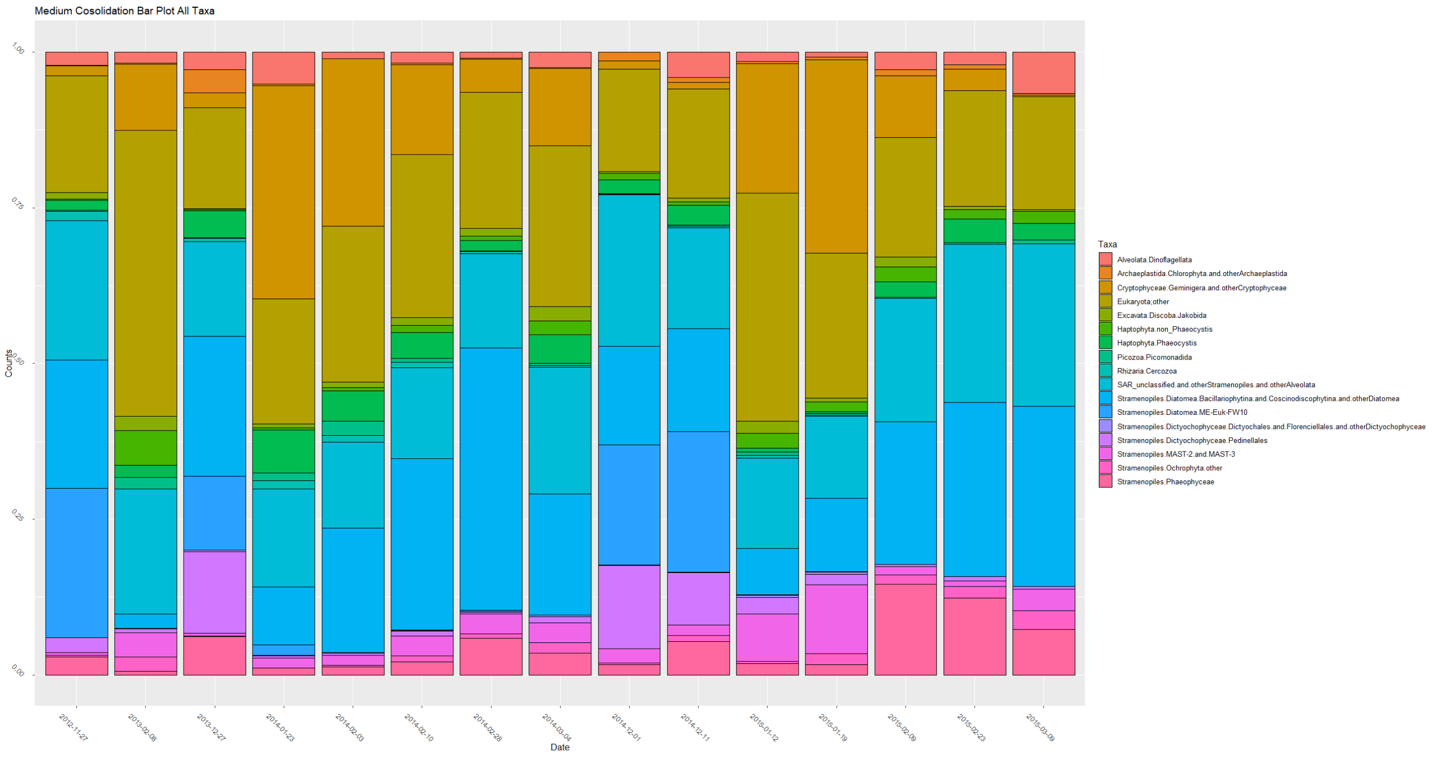

Slide 7
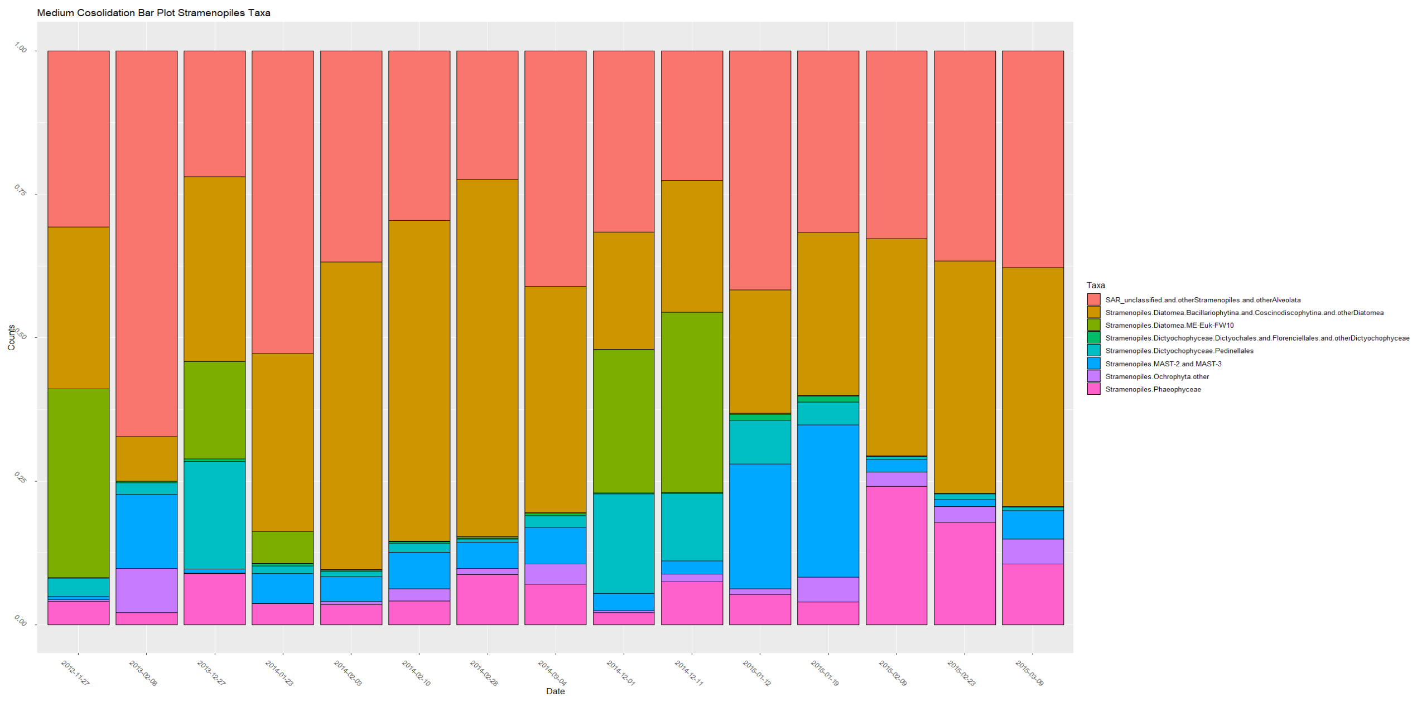

Slide 8
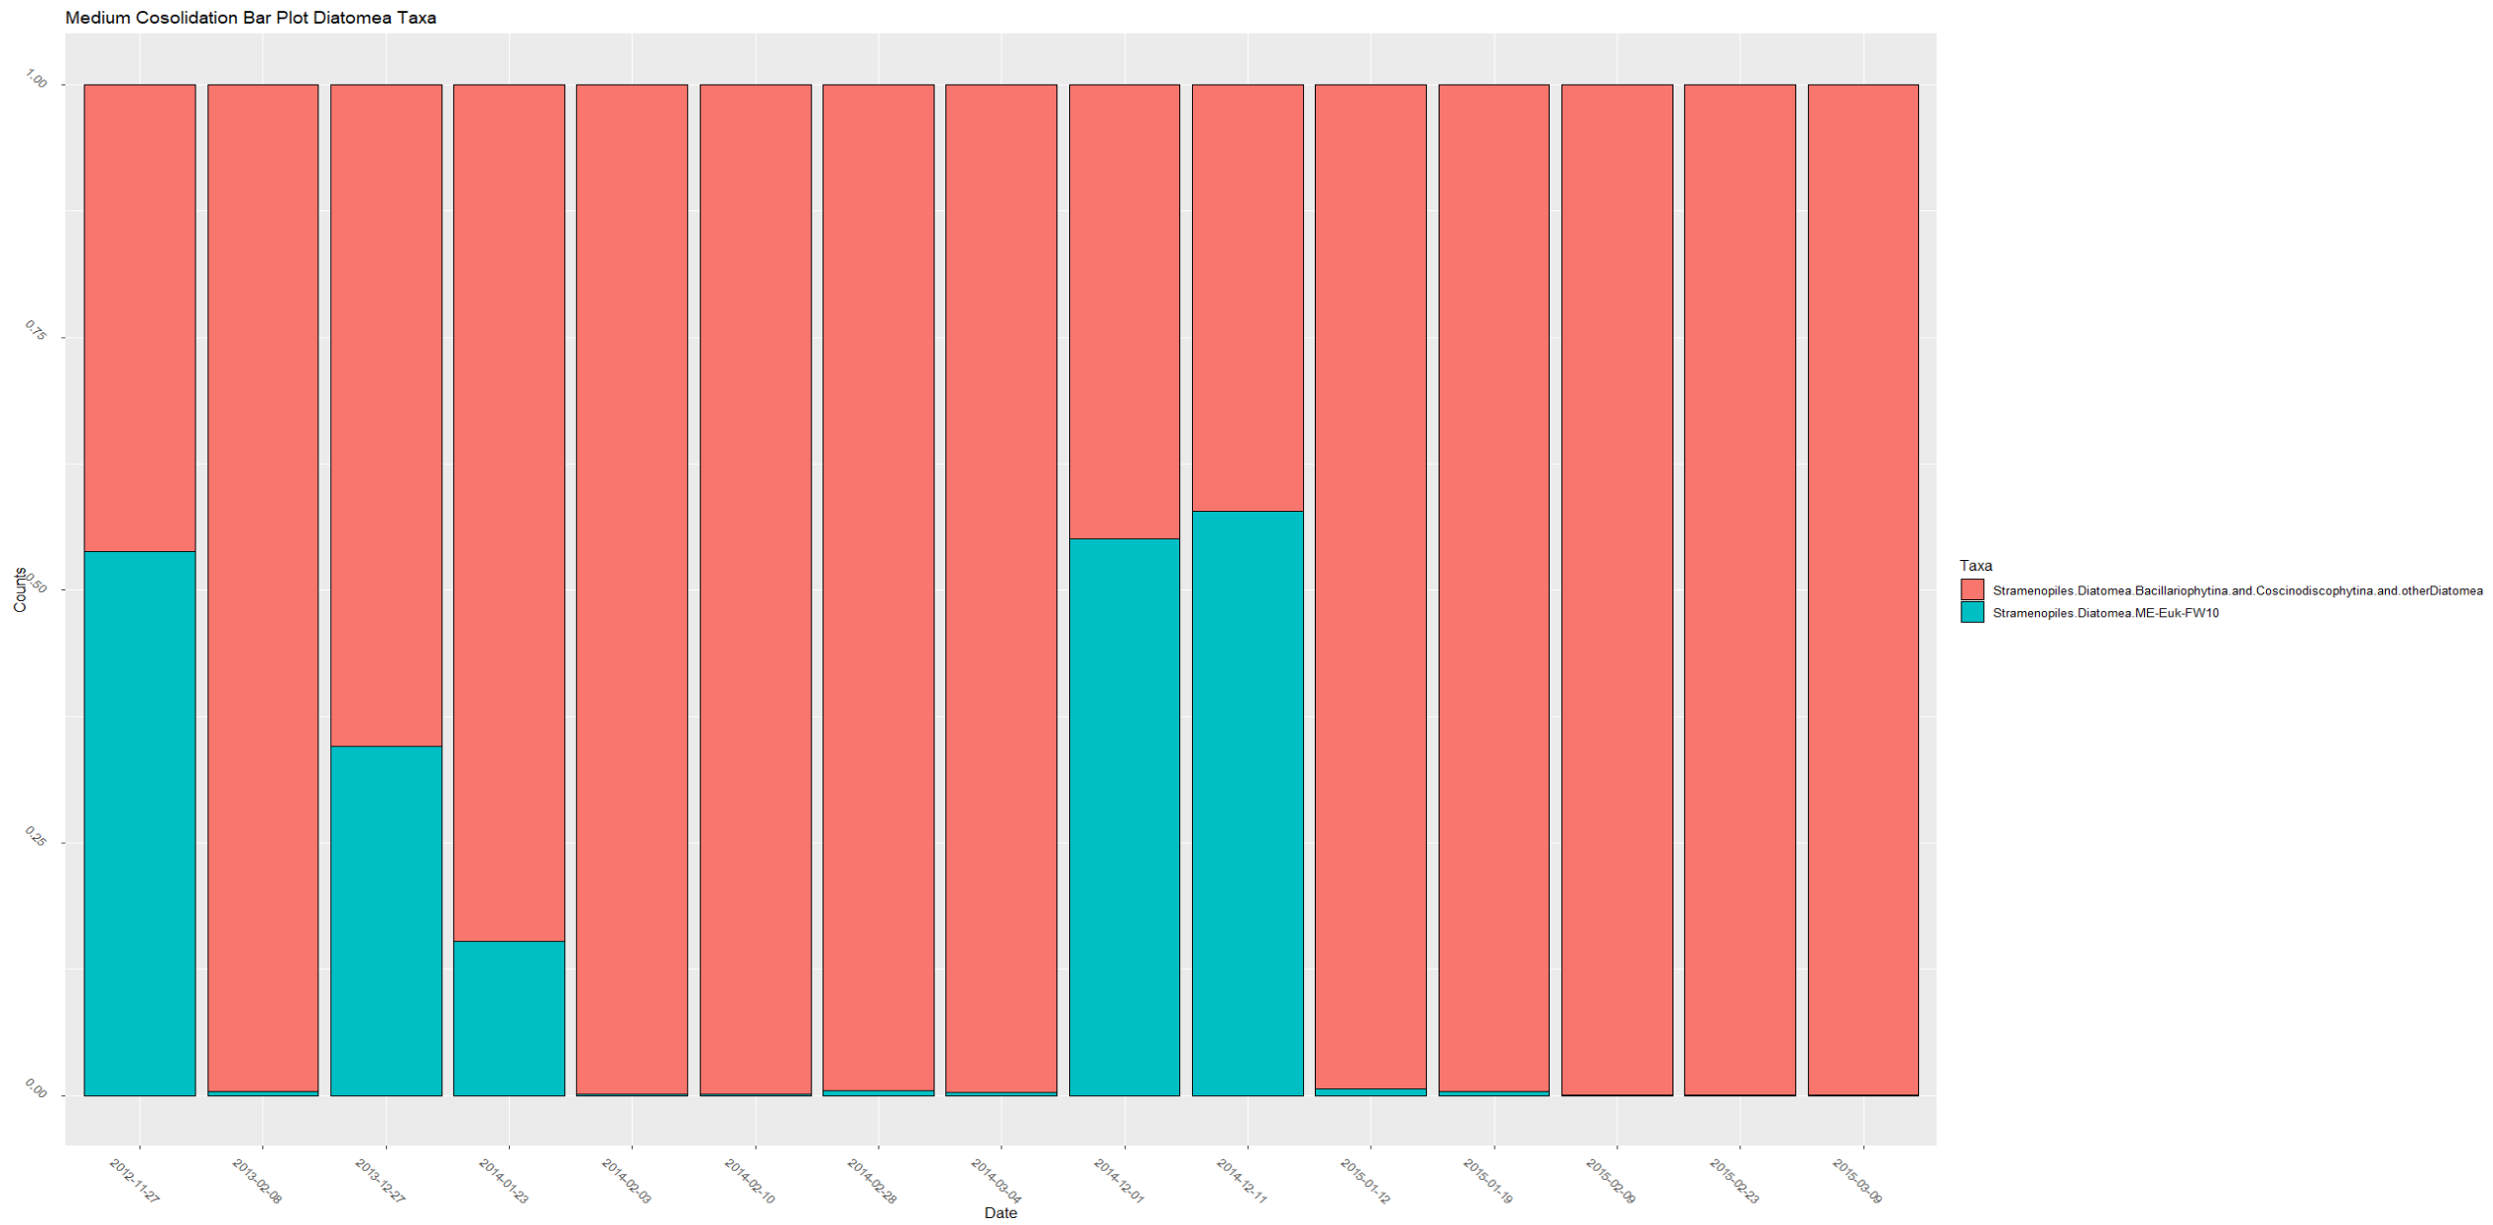

Slide 9
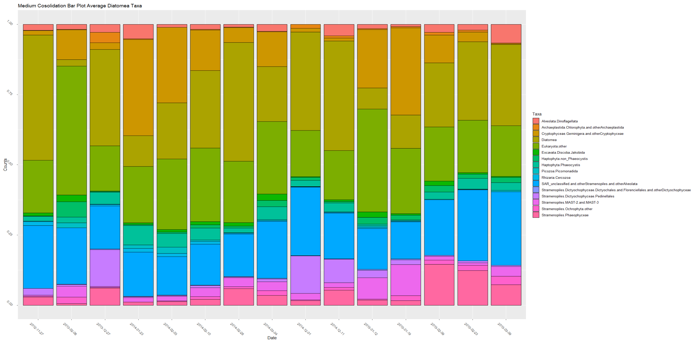

Slide 10
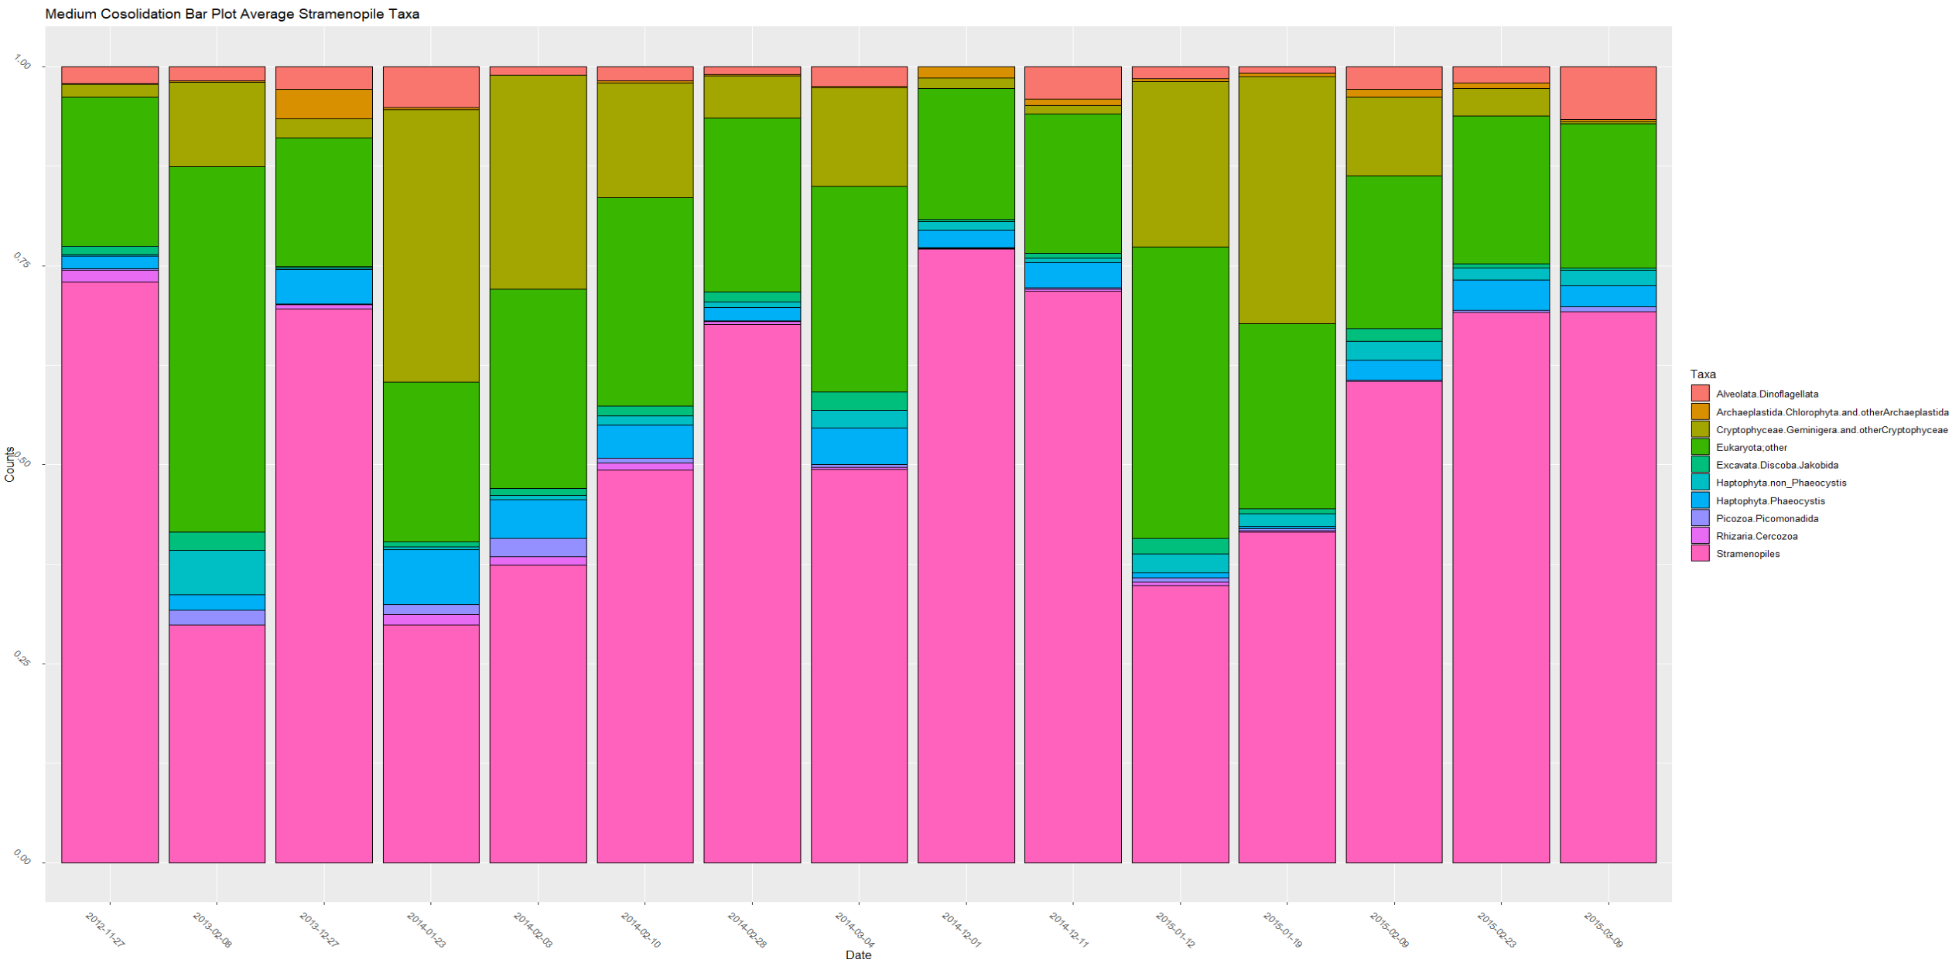

Slide 11
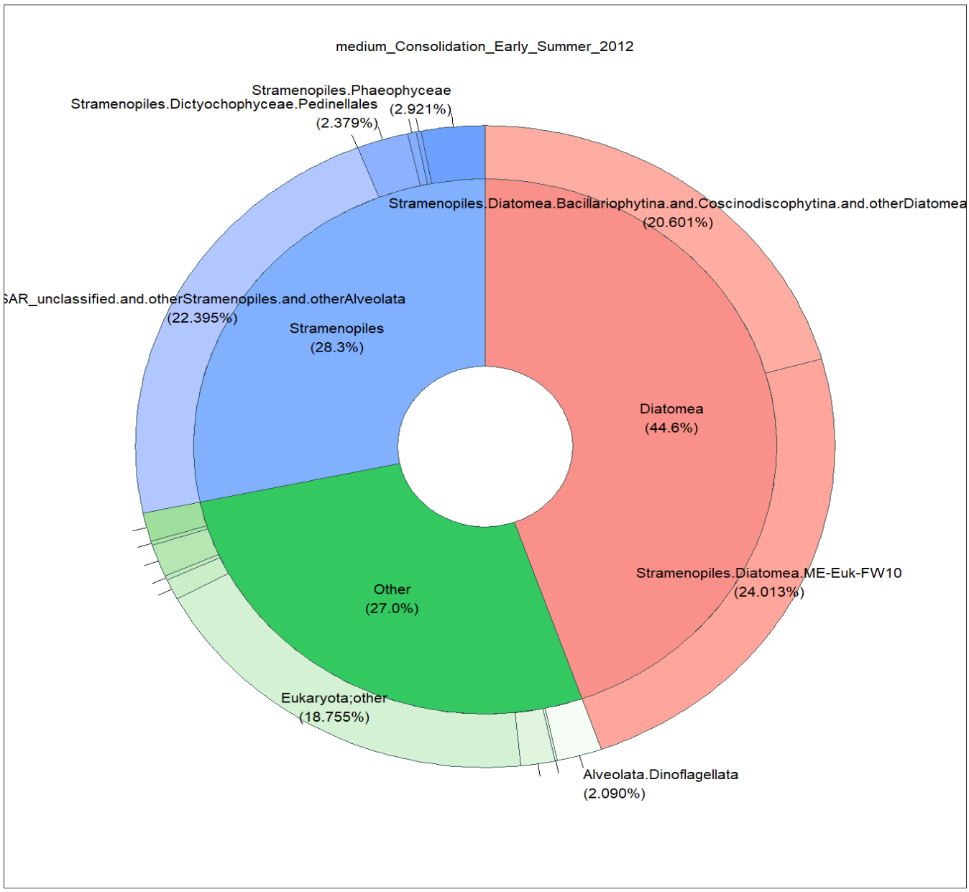

Slide 12
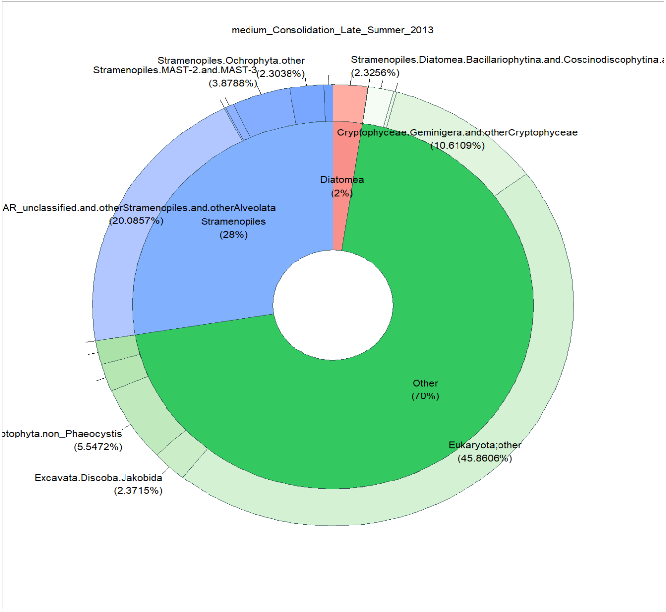

Slide 13
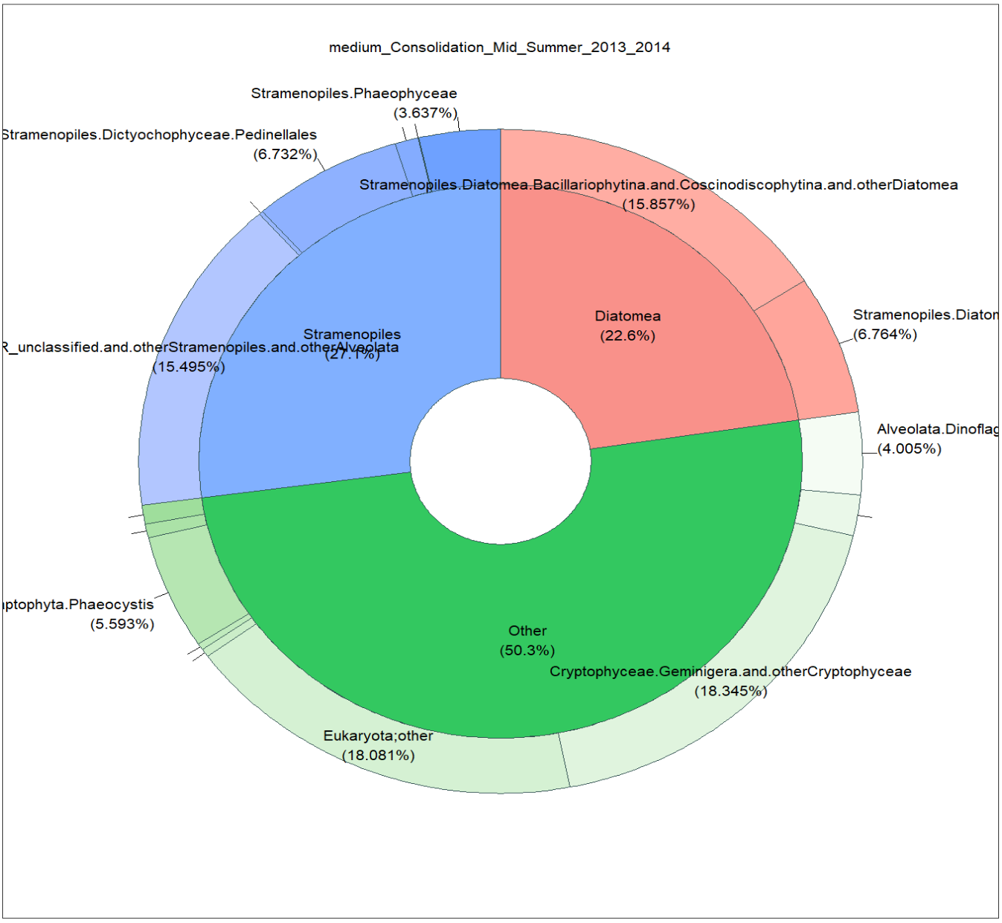

Slide 14
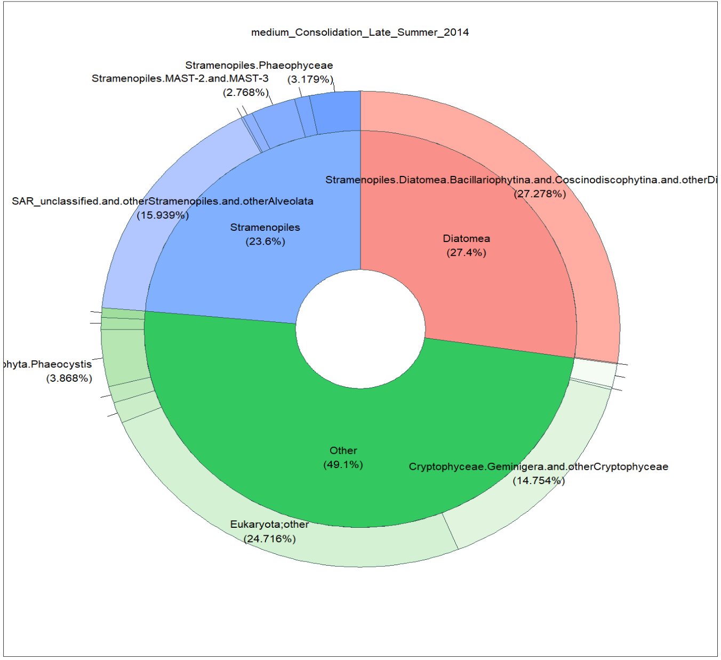

Slide 15
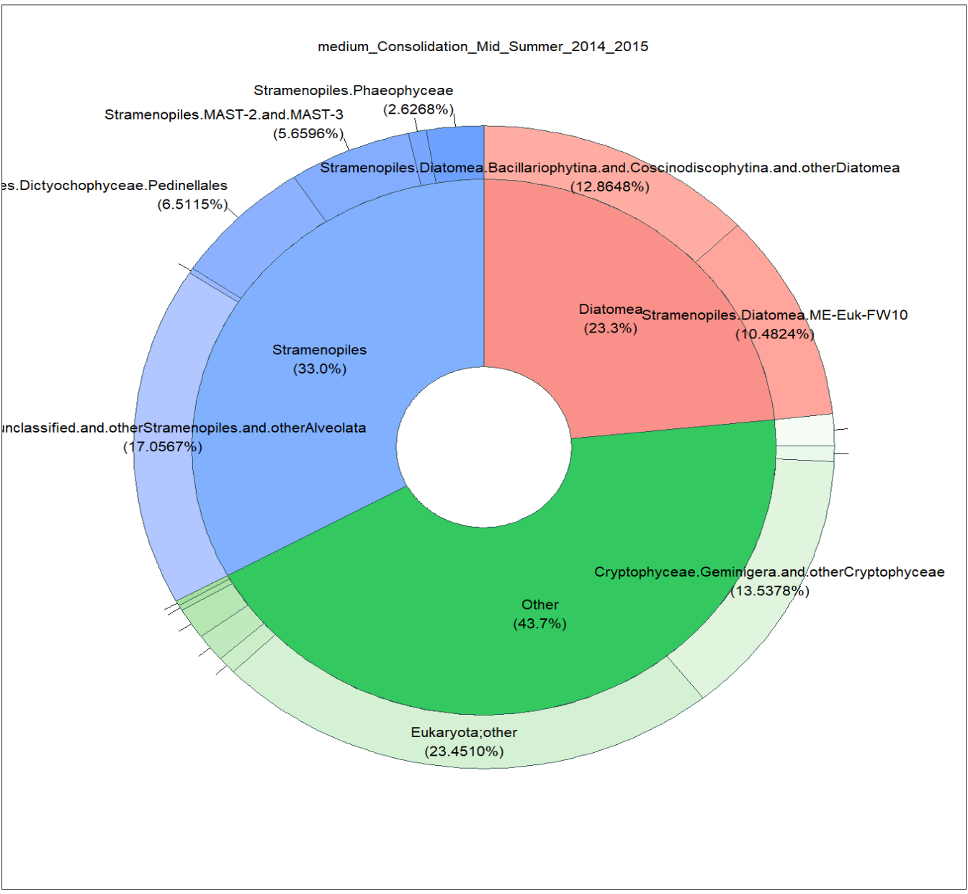

Slide 16
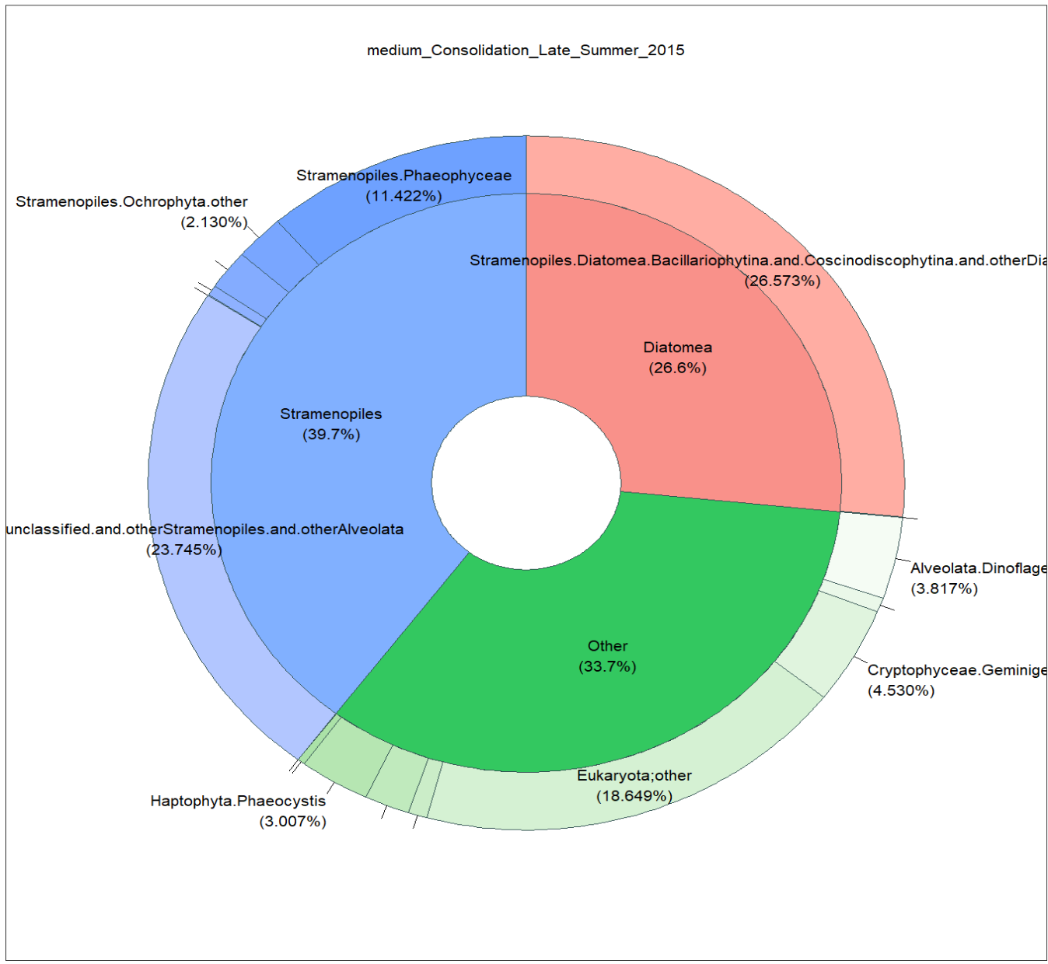

Slide 17
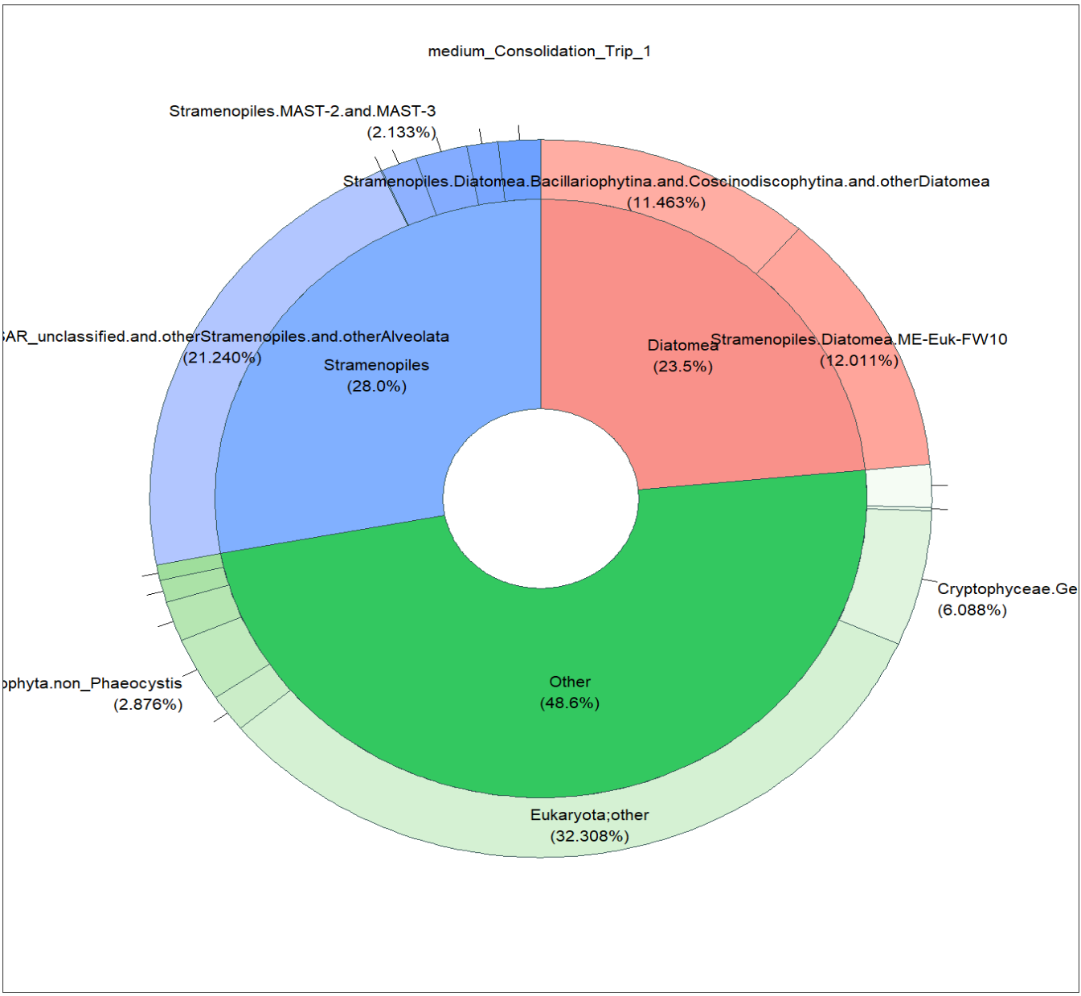

Slide 18
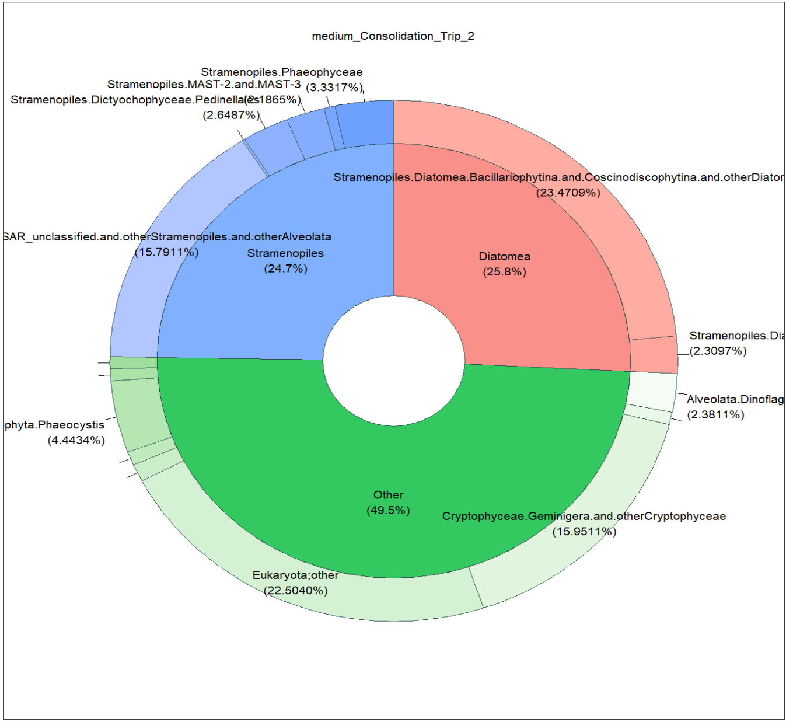

Slide 19
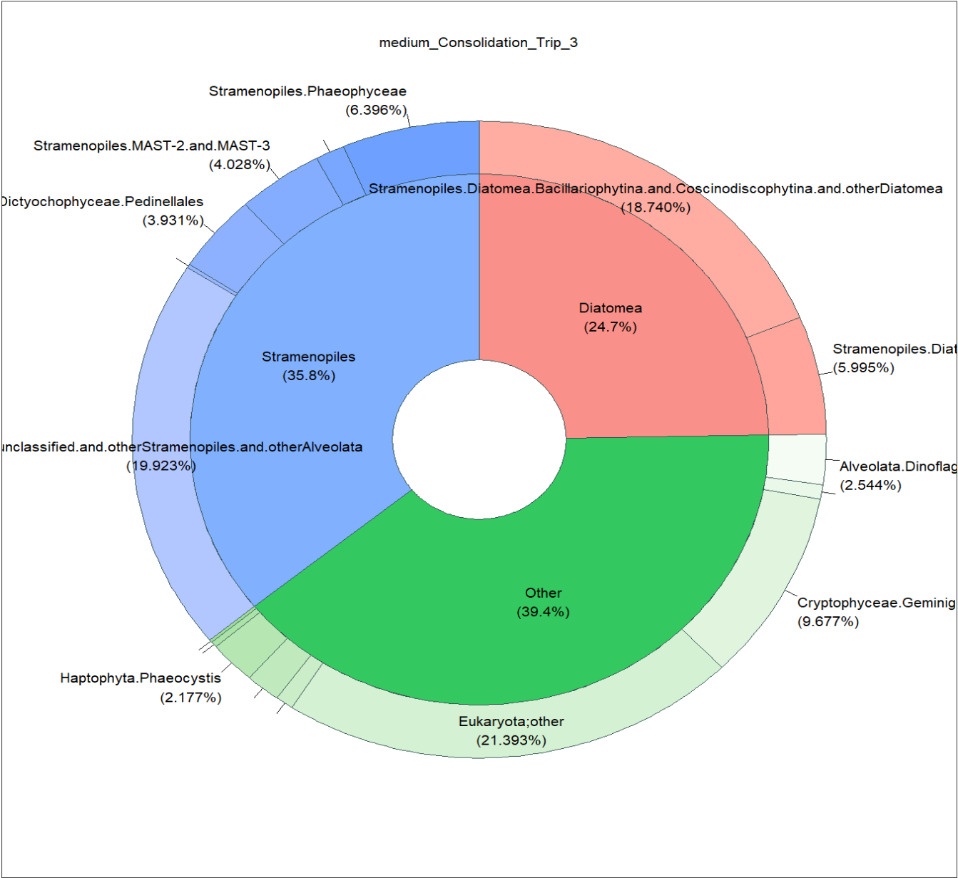

Slide 20
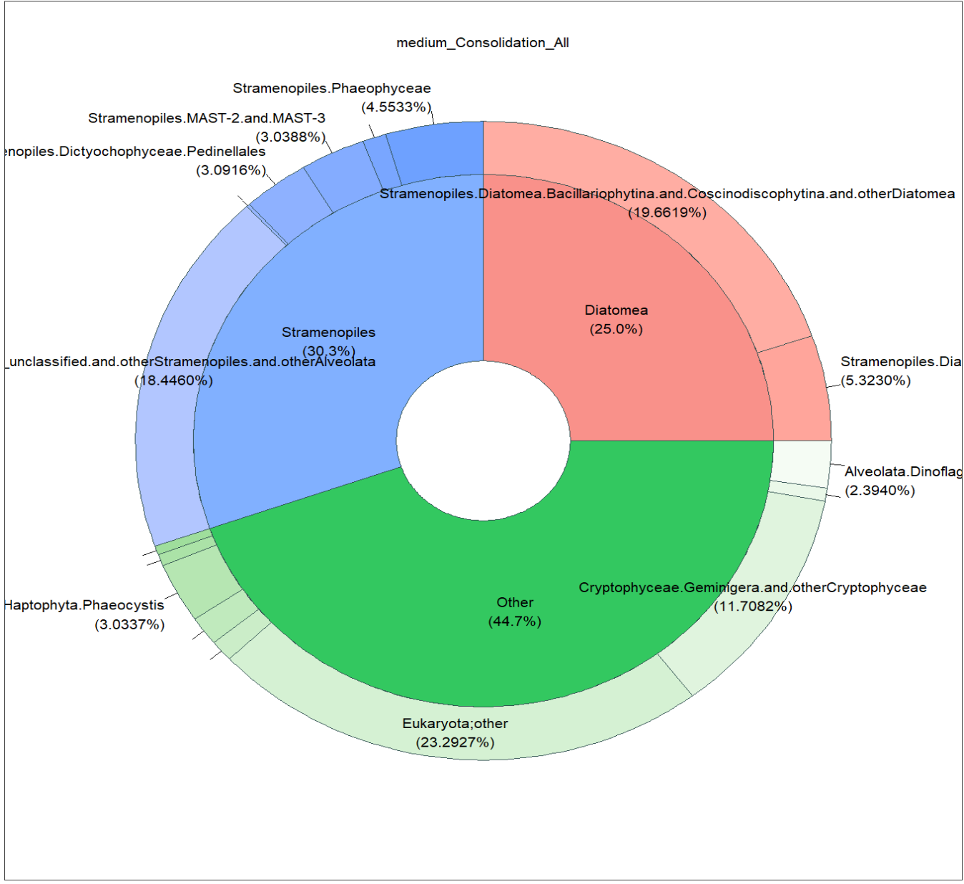

Slide 21
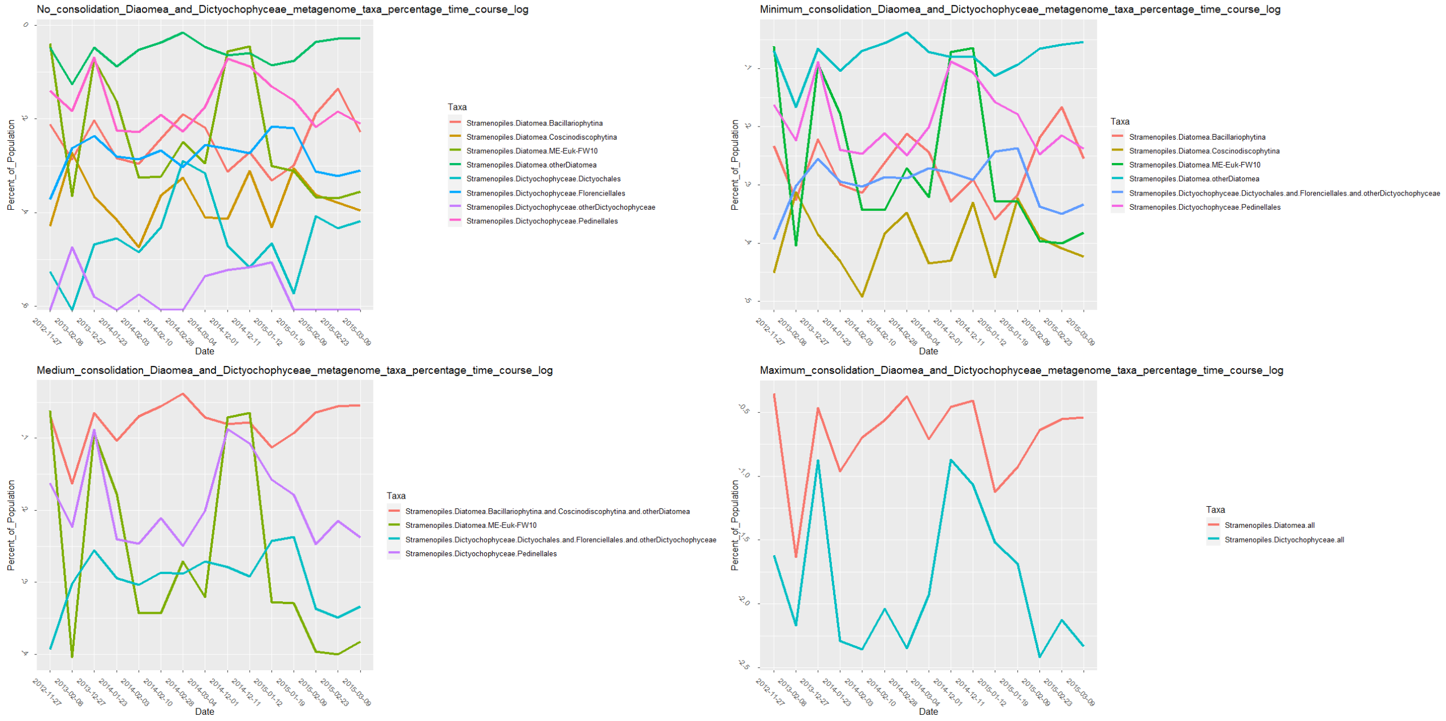
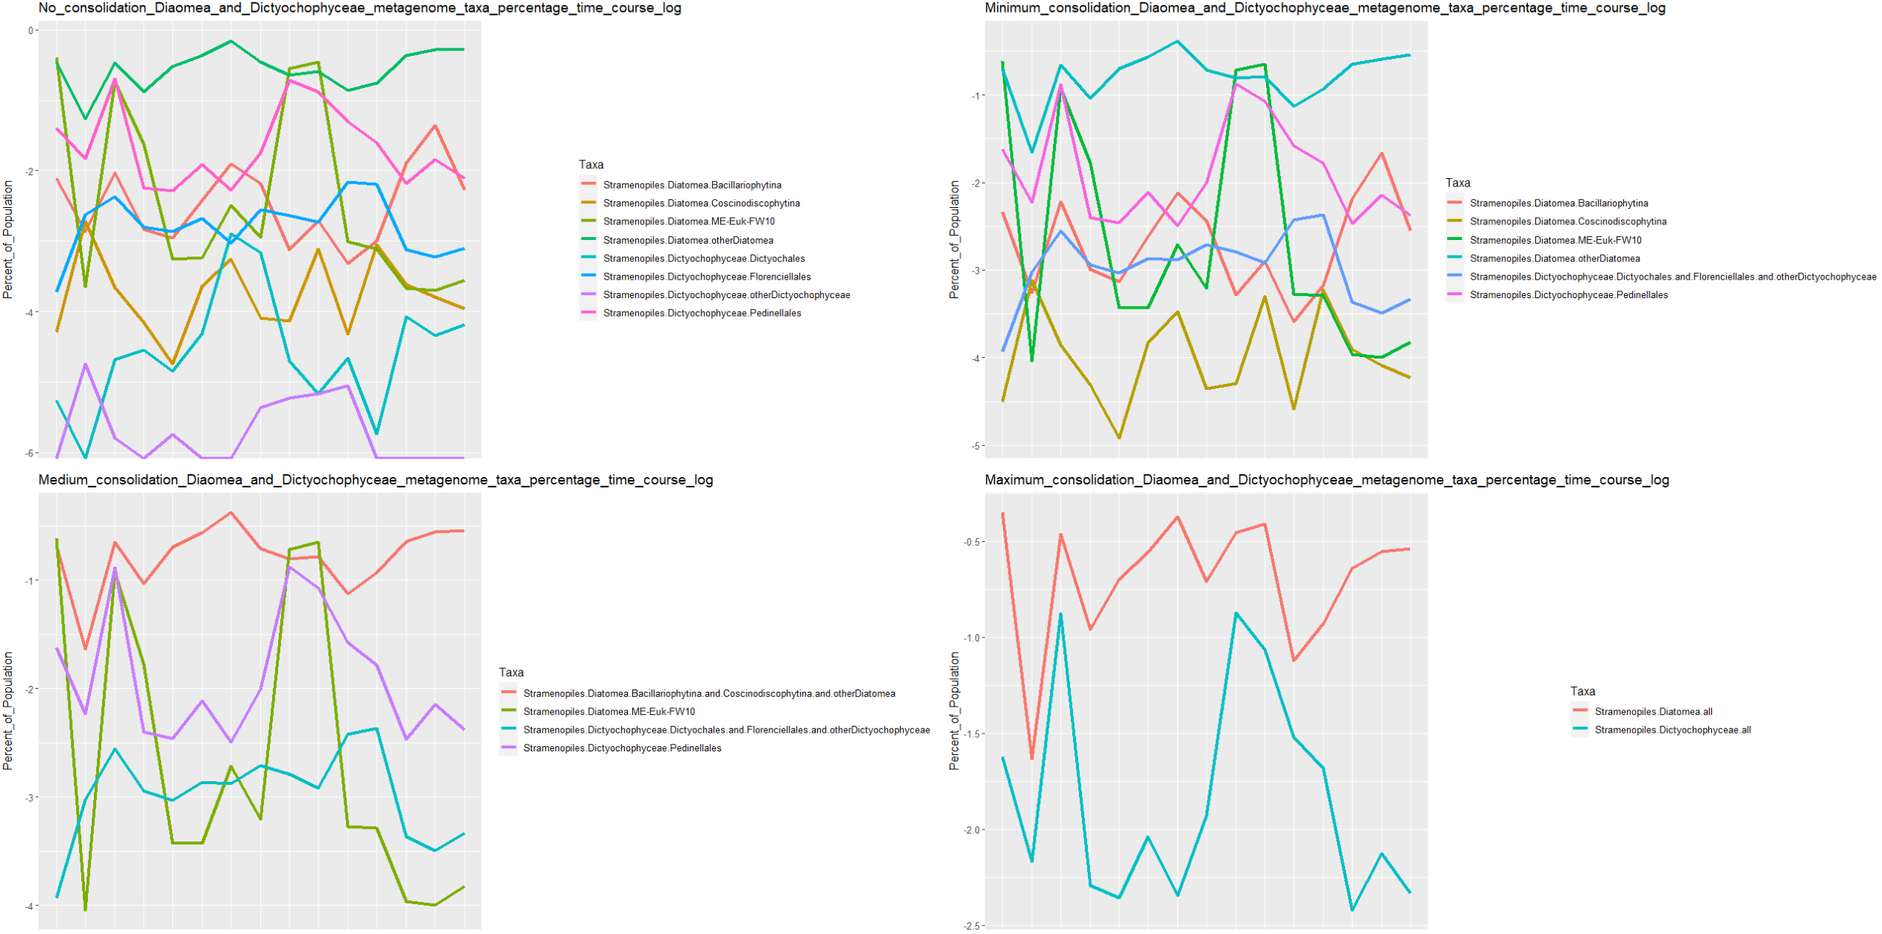

Slide 22
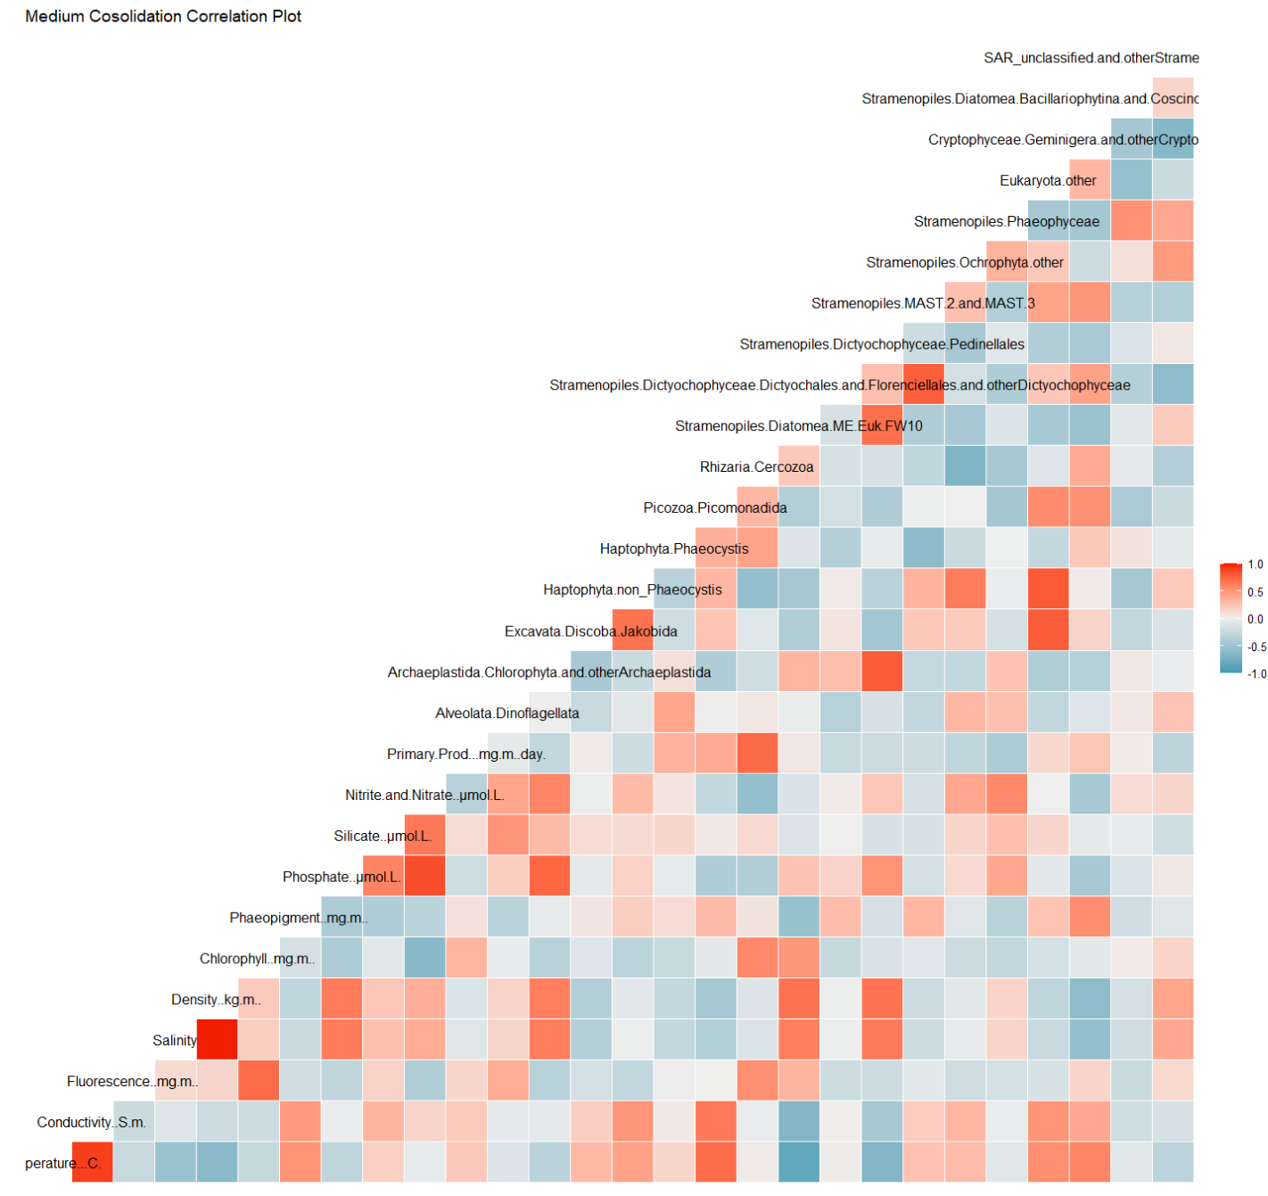

Slide 23
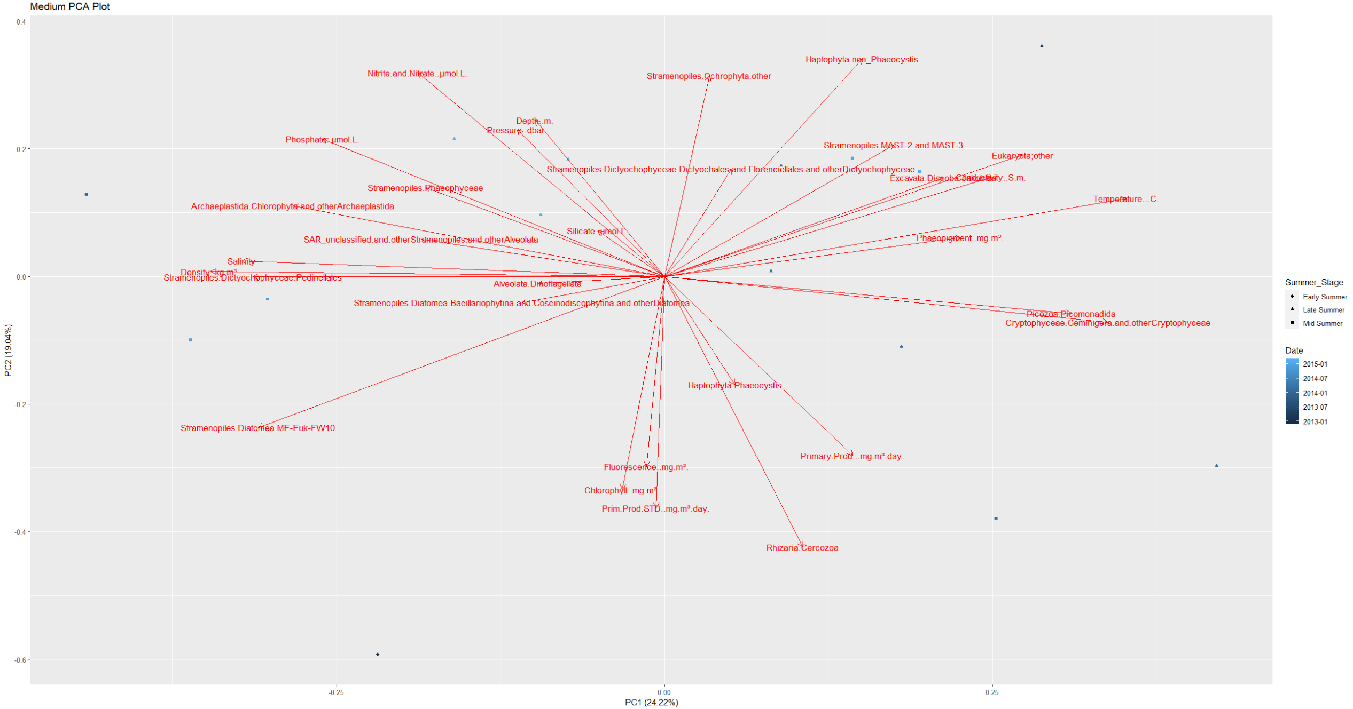

Slide 24
Groups
Group 1:
Archaeplastida.Chlorophyta.and.otherArchaeplastida, Stramenopiles.Diatomea.ME_Euk_FW10, Stramenopiles.Dictyochophyceae.Pedinellales
Group 2:
Excavata.Discoba.Jakobida, Haptophyta.non_Phaeocystis, Eukaryota_other
Group 3:
Picozoa.Picomonadida
Group 4:
Stramenopiles.Dictyochophyceae.Dictyochales.and.Florenciellales.and.otherDictyochophyceae, Stramenopiles.MAST_2.and.MAST_3, Stramenopiles.Ochrophyta.other

Slide 25
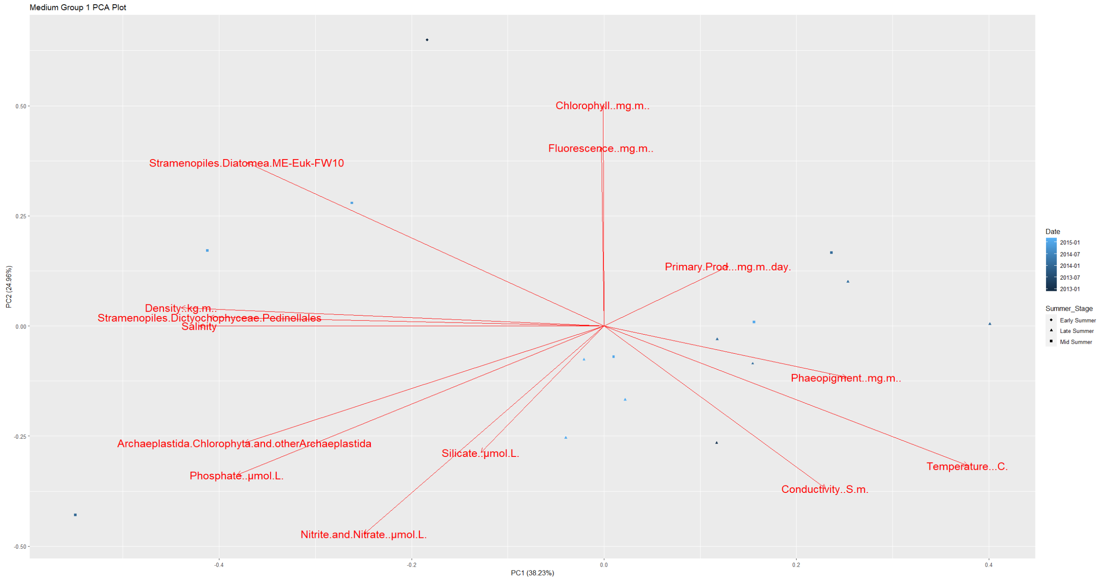

Slide 26
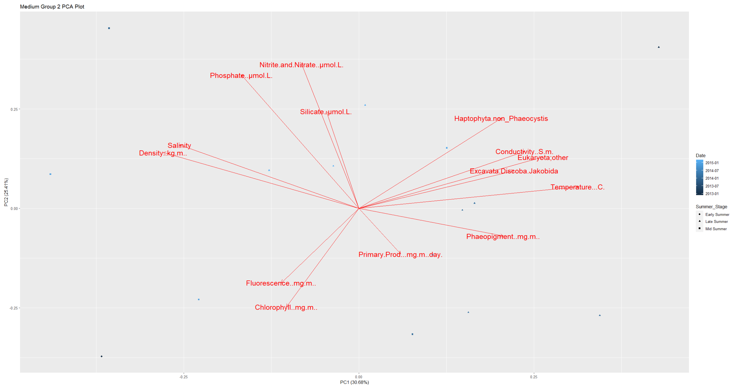

Slide 27
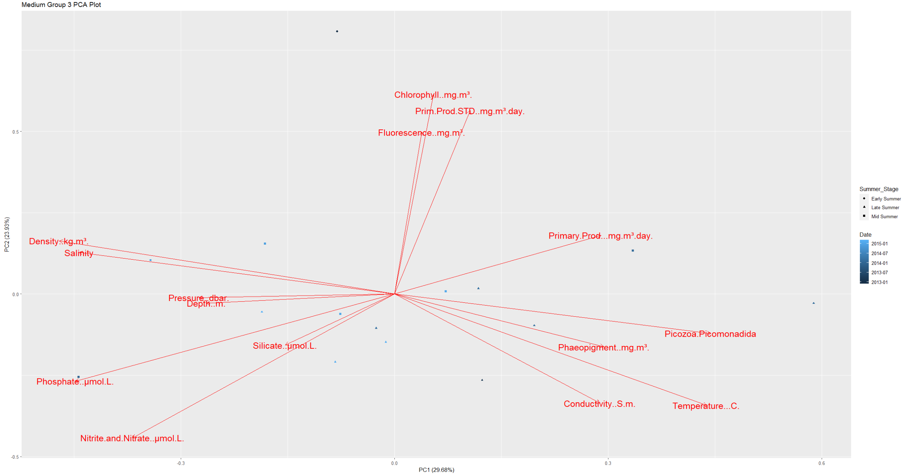

Slide 28
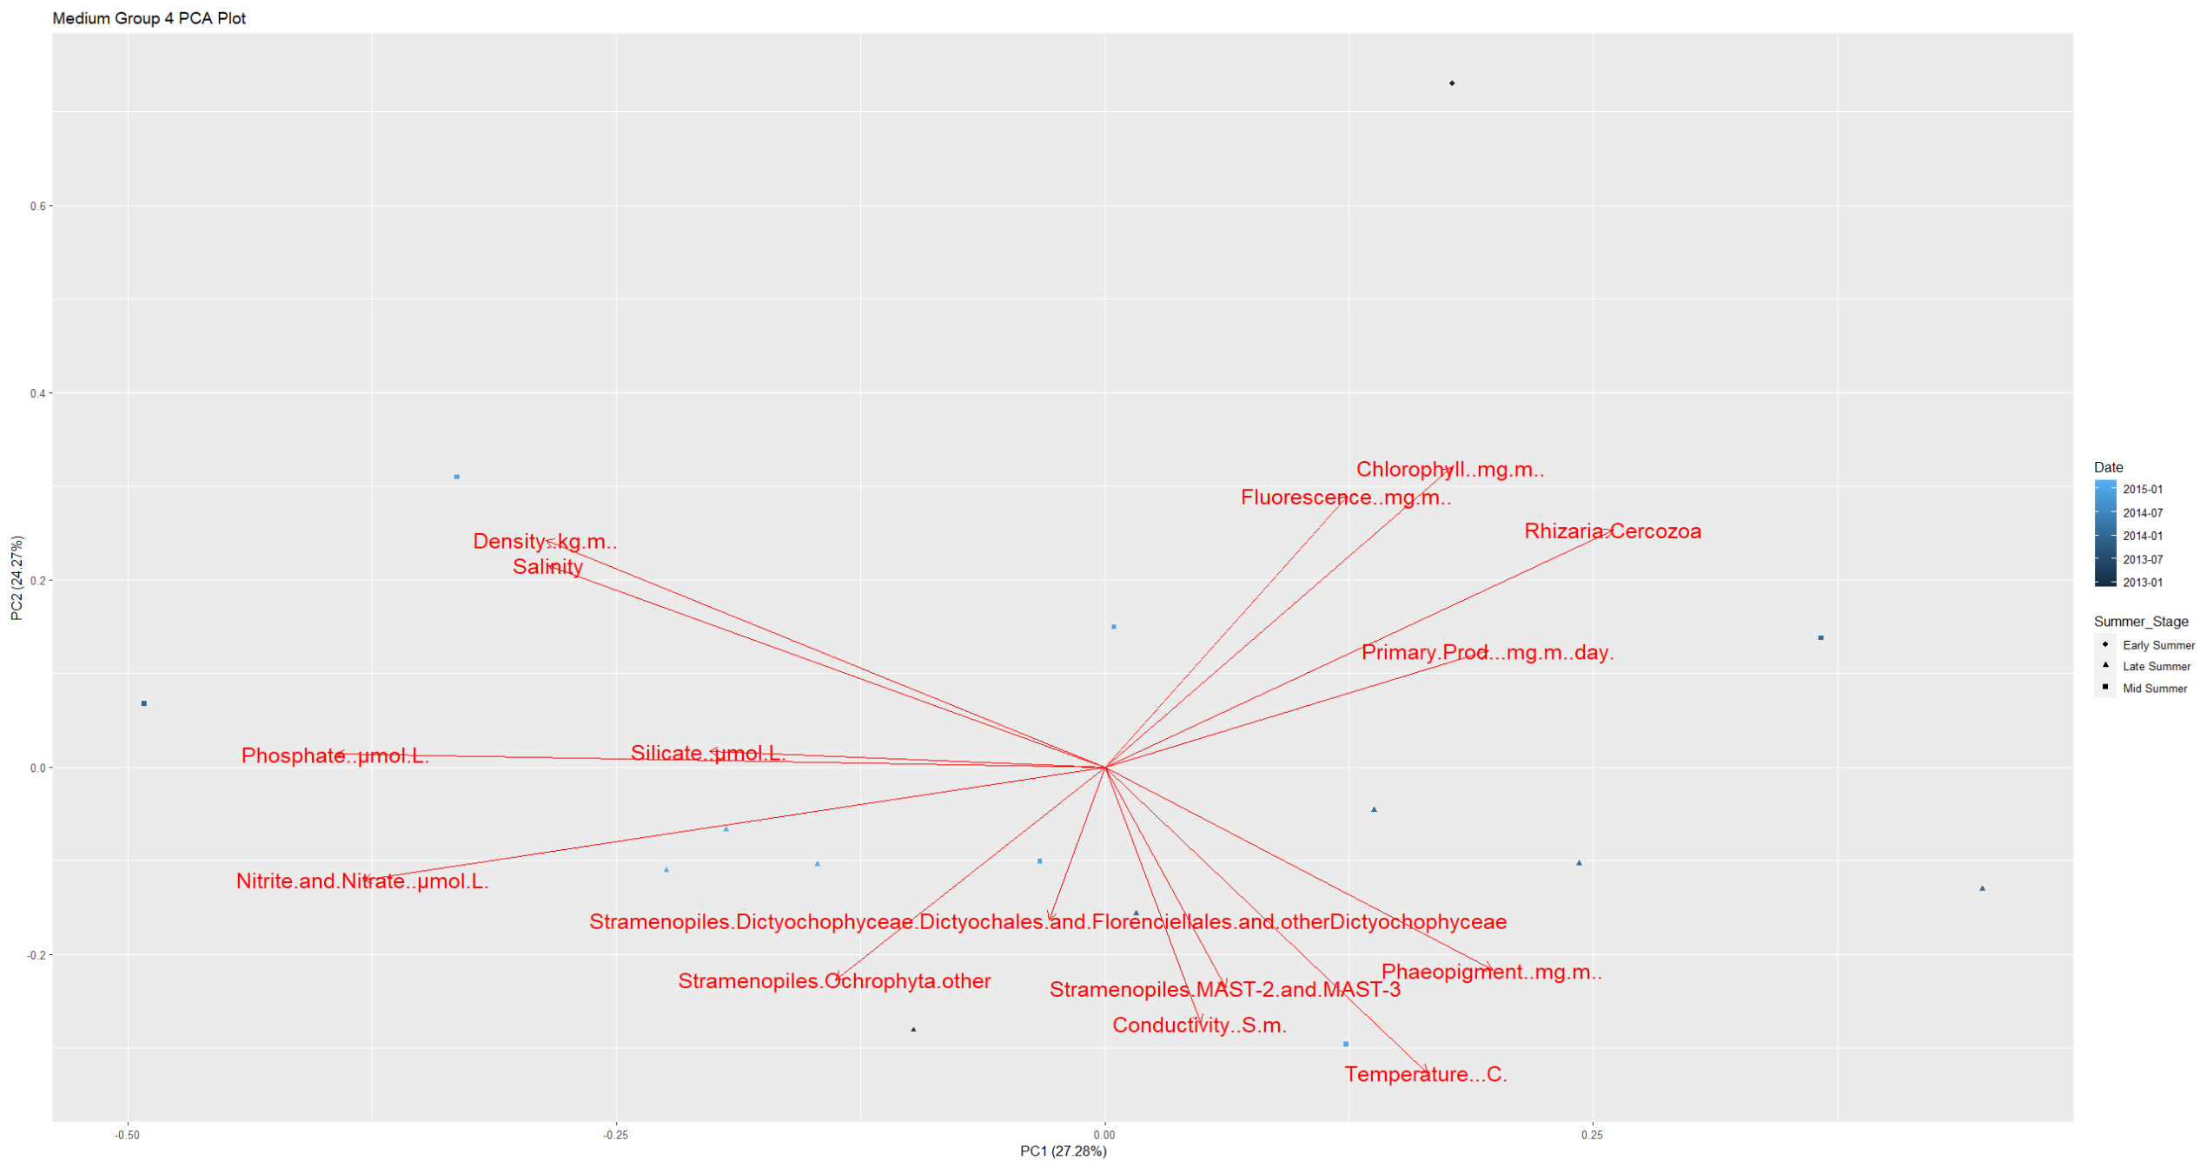

Slide 29
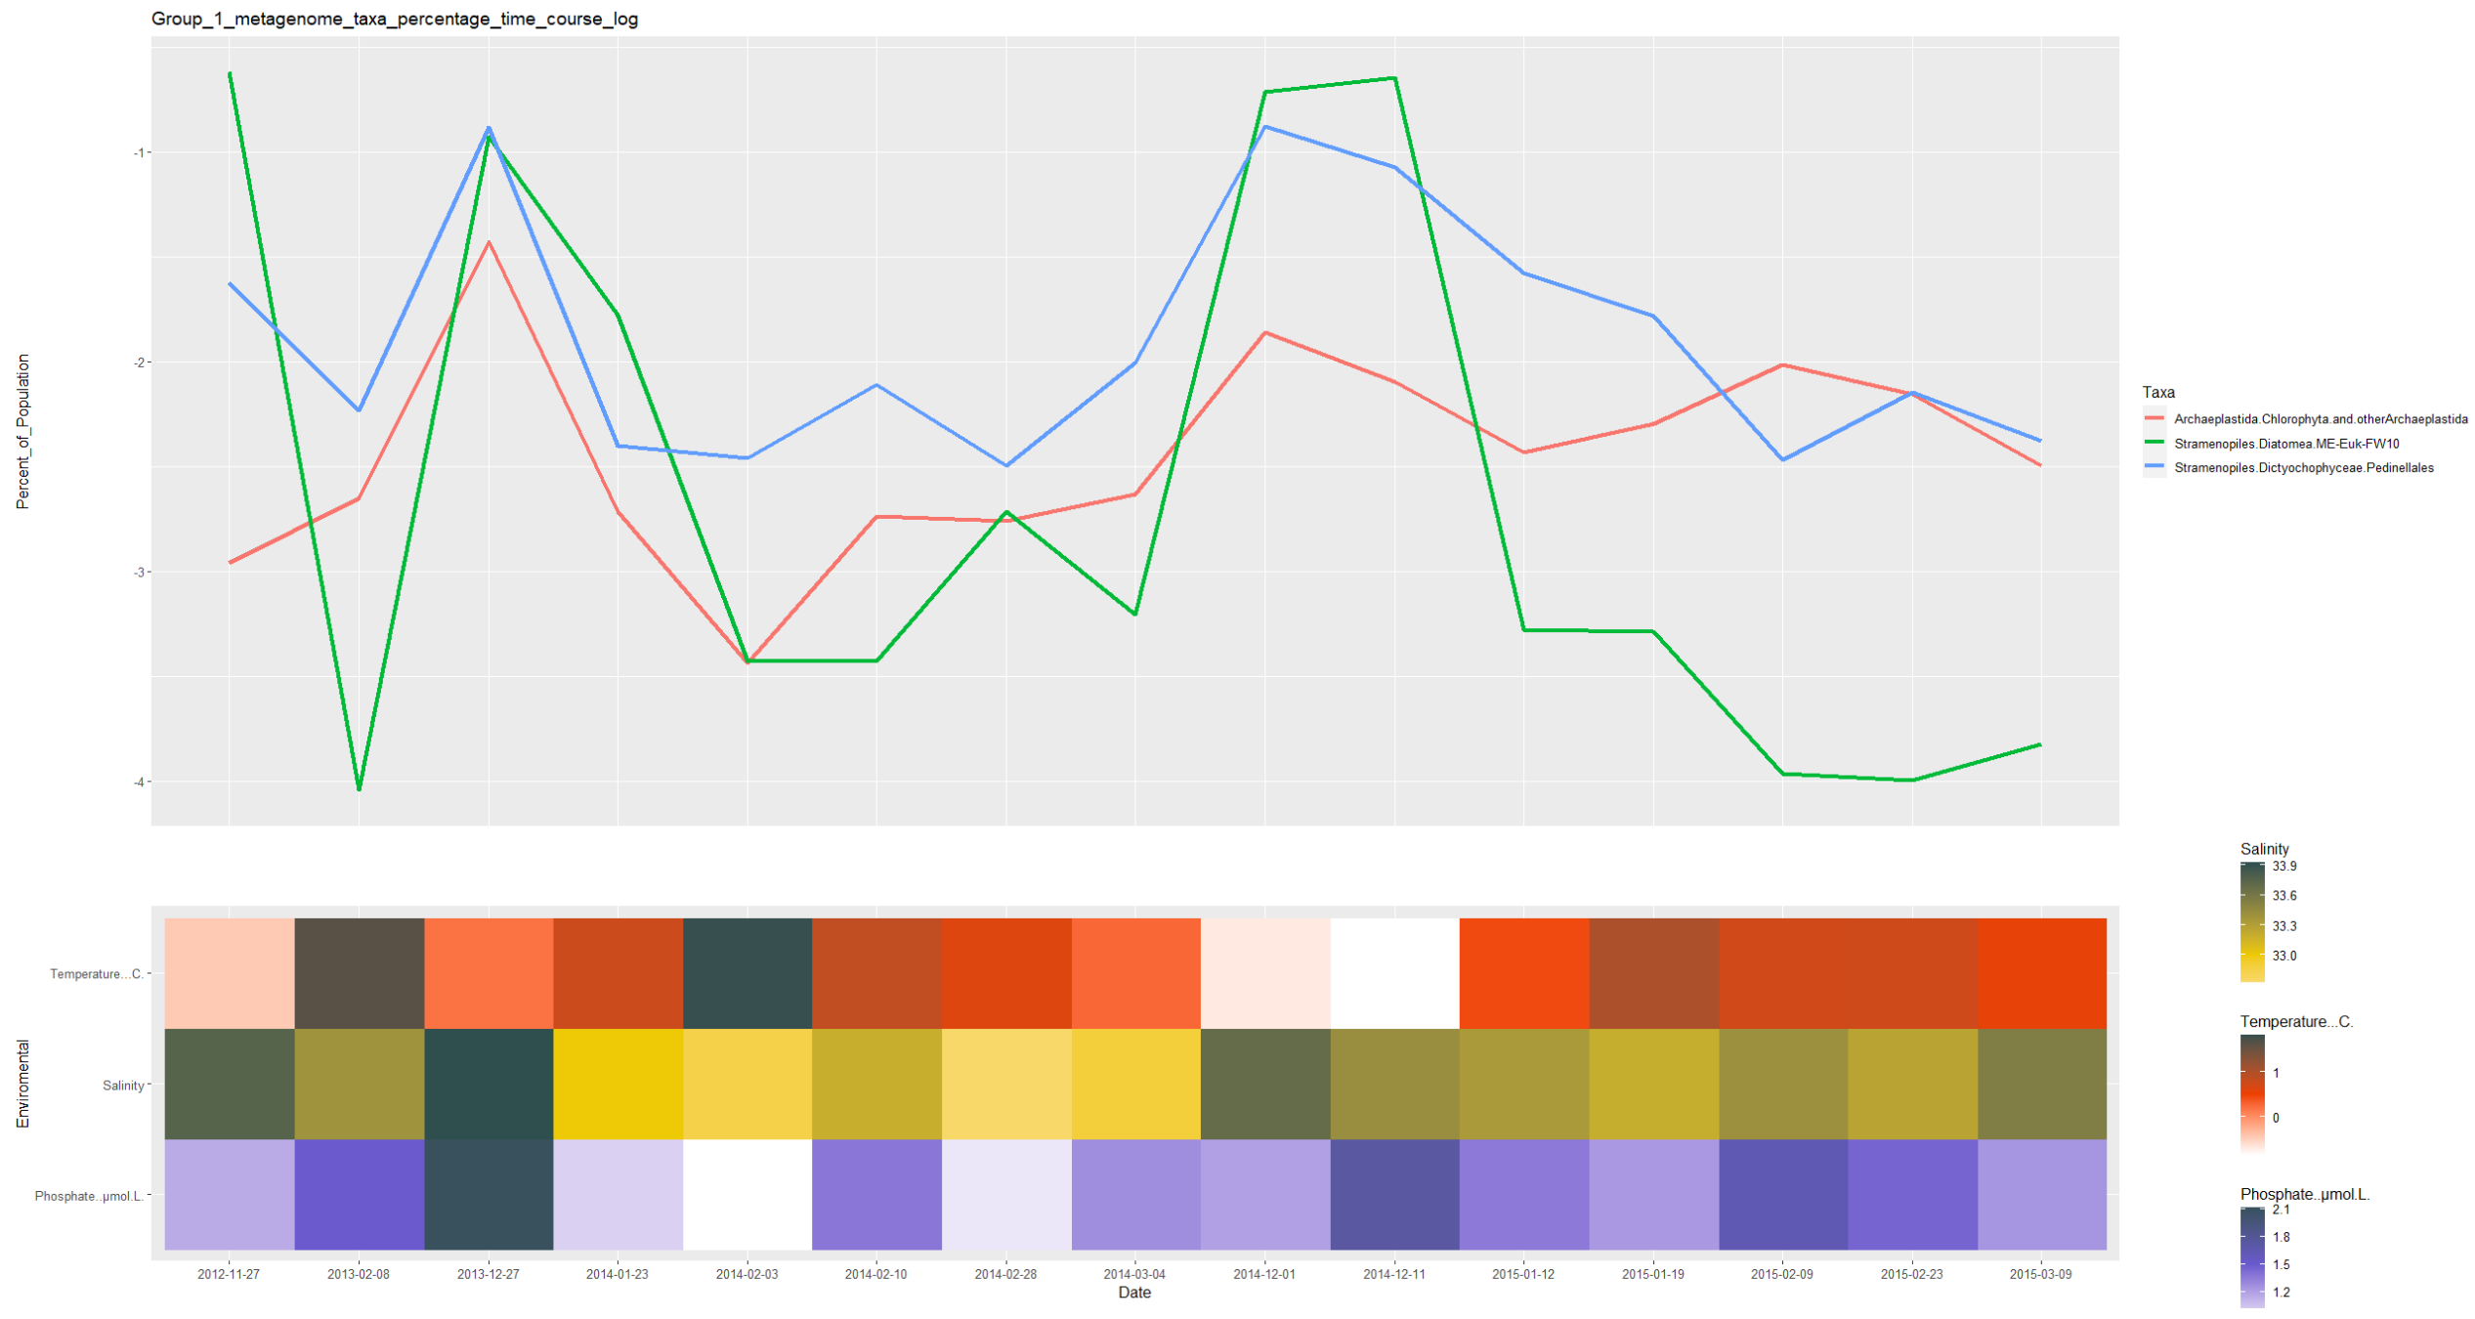

Slide 30
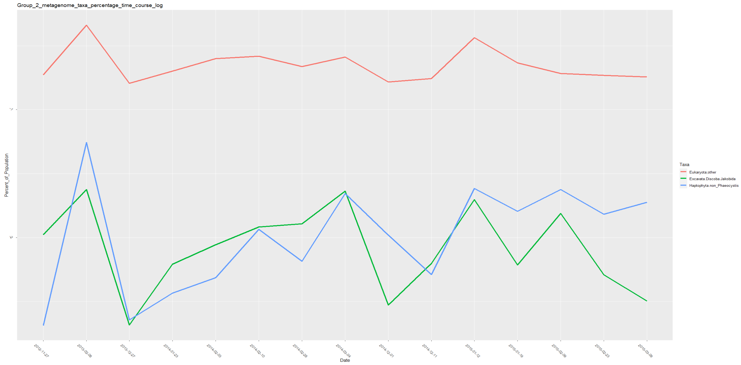

Slide 31
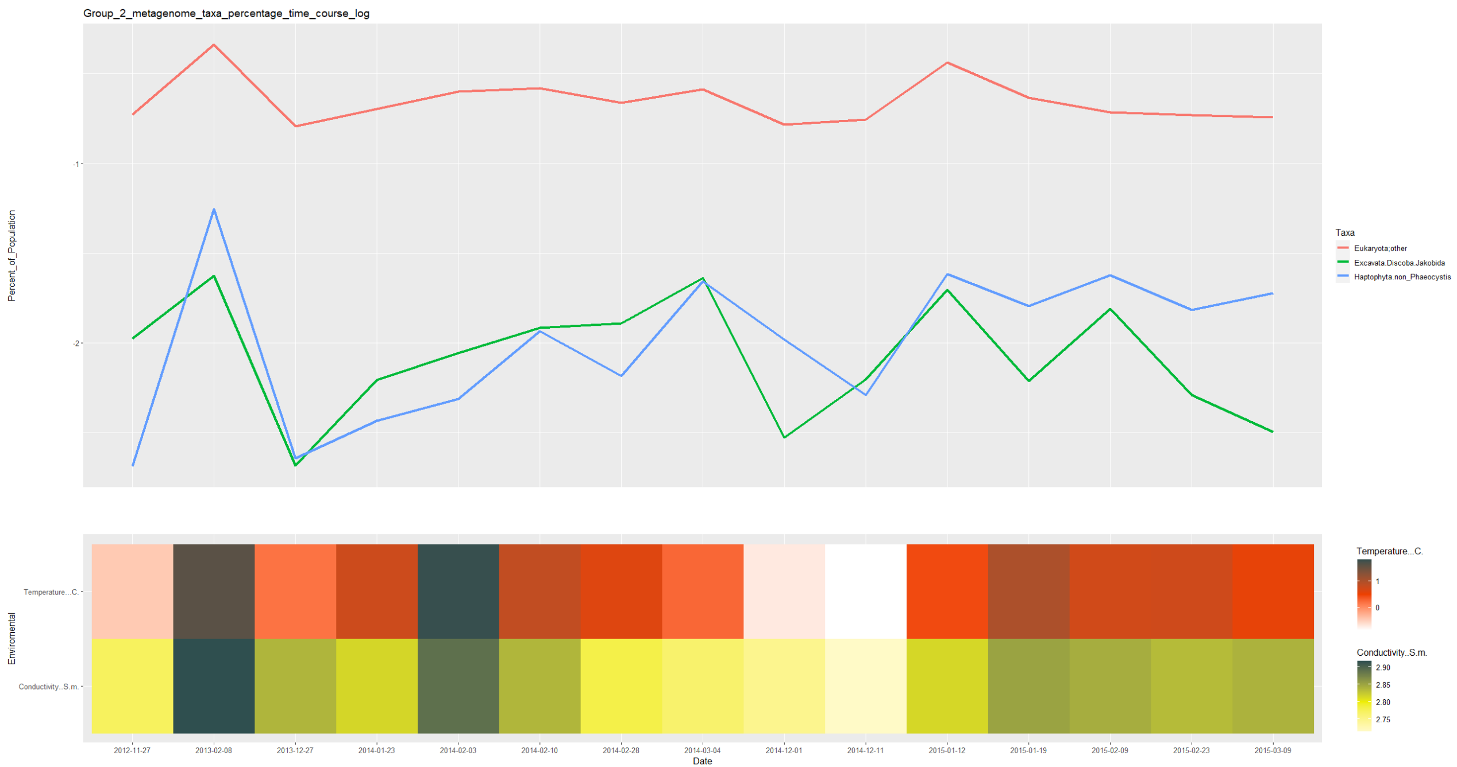

Slide 32
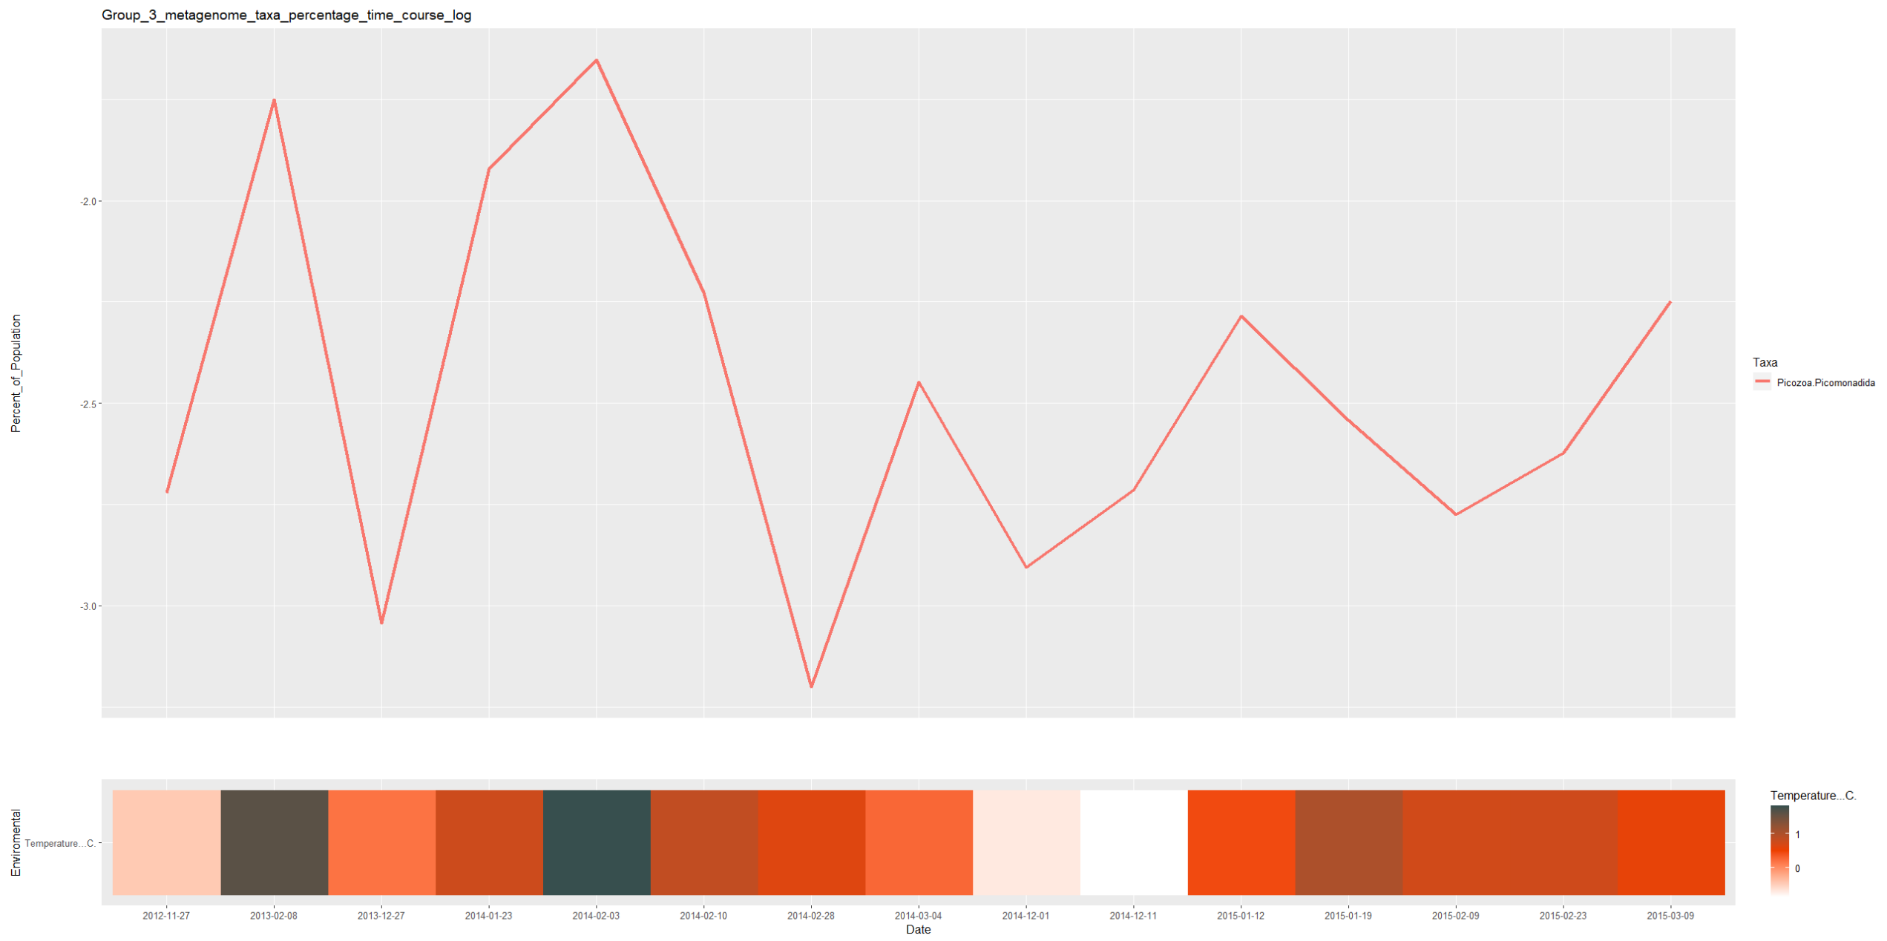

Slide 33
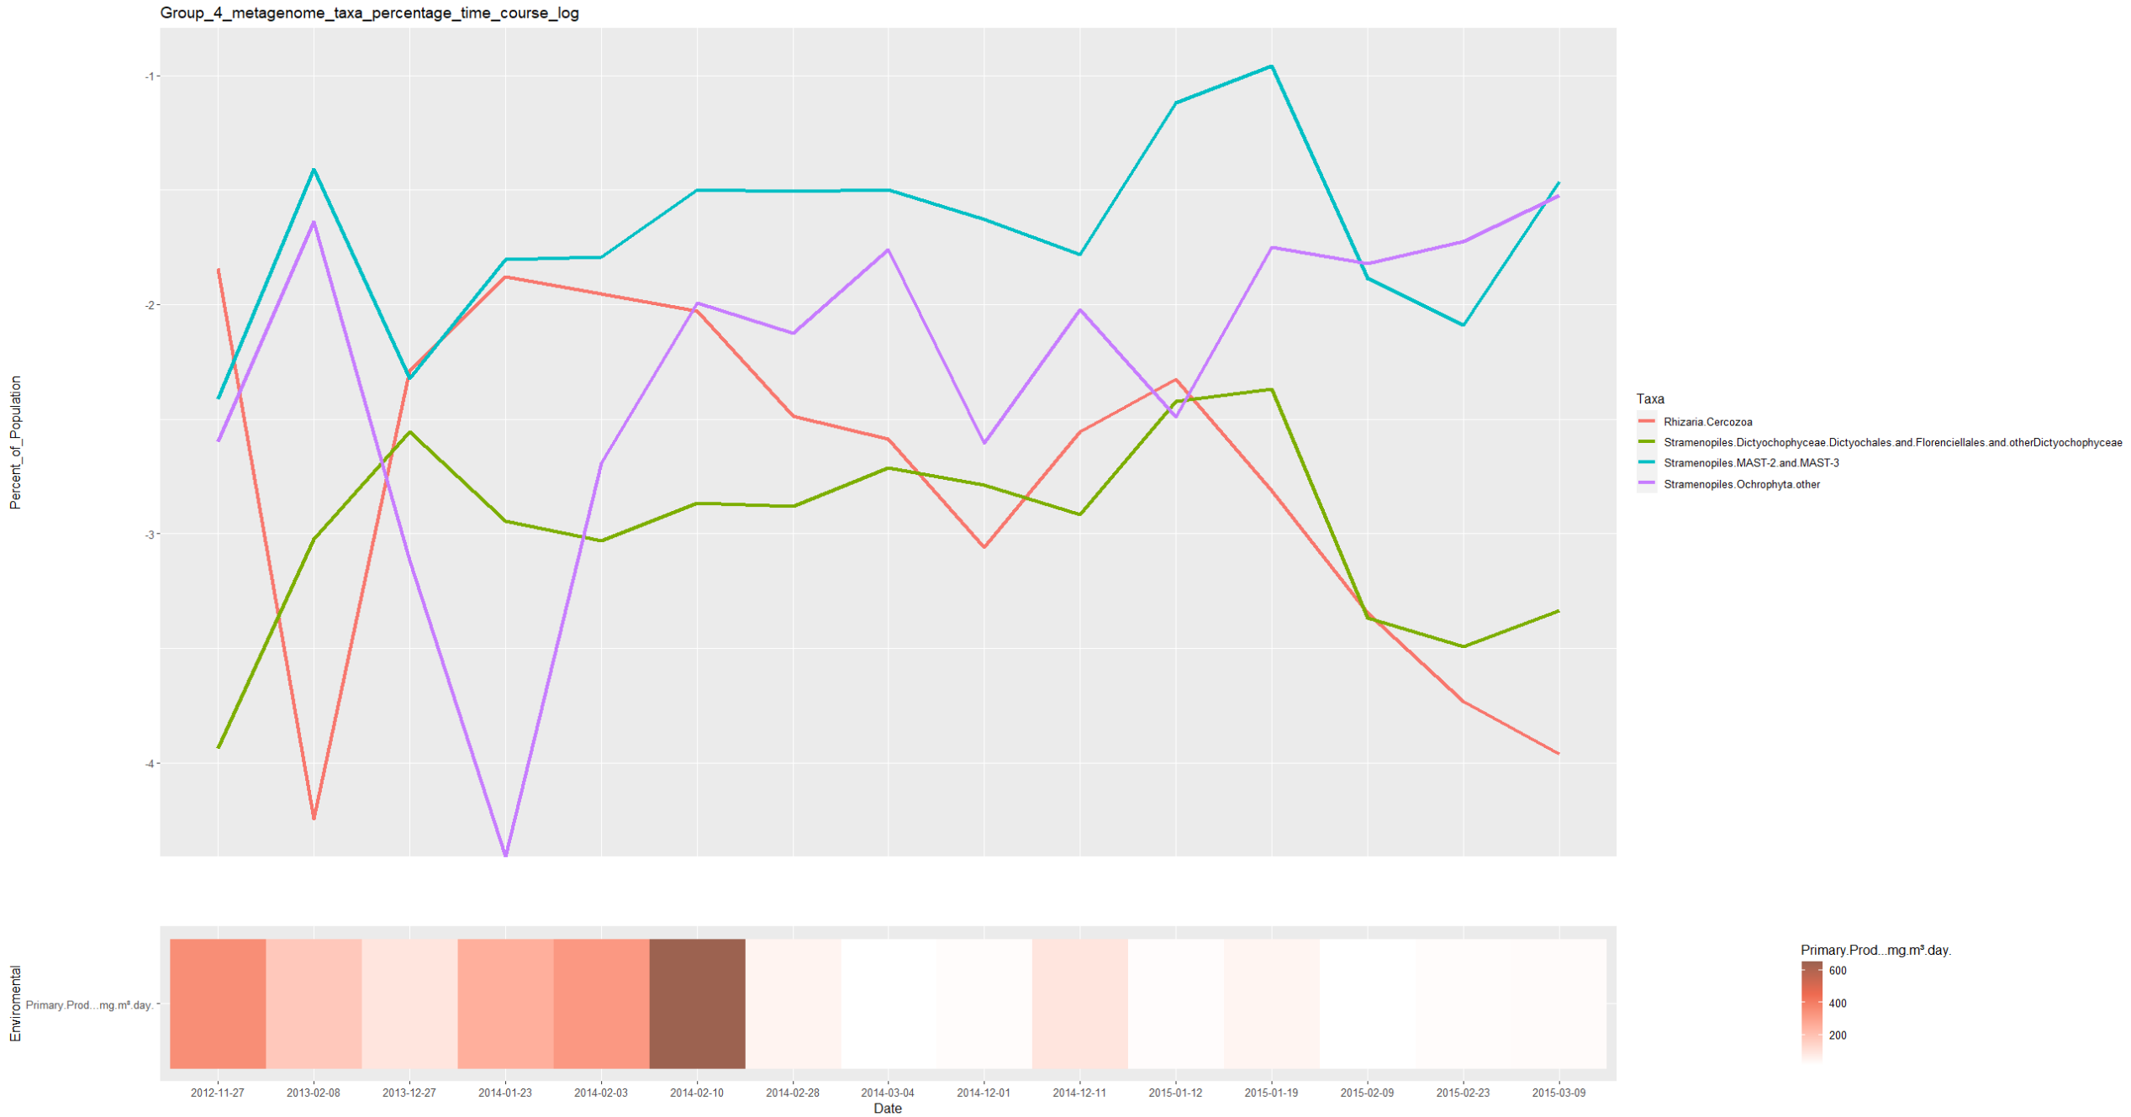

Slide 34
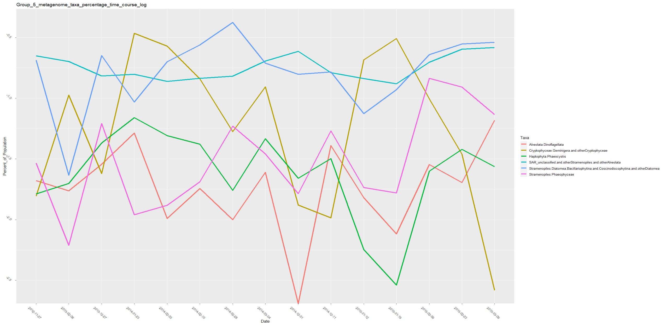

Slide 35
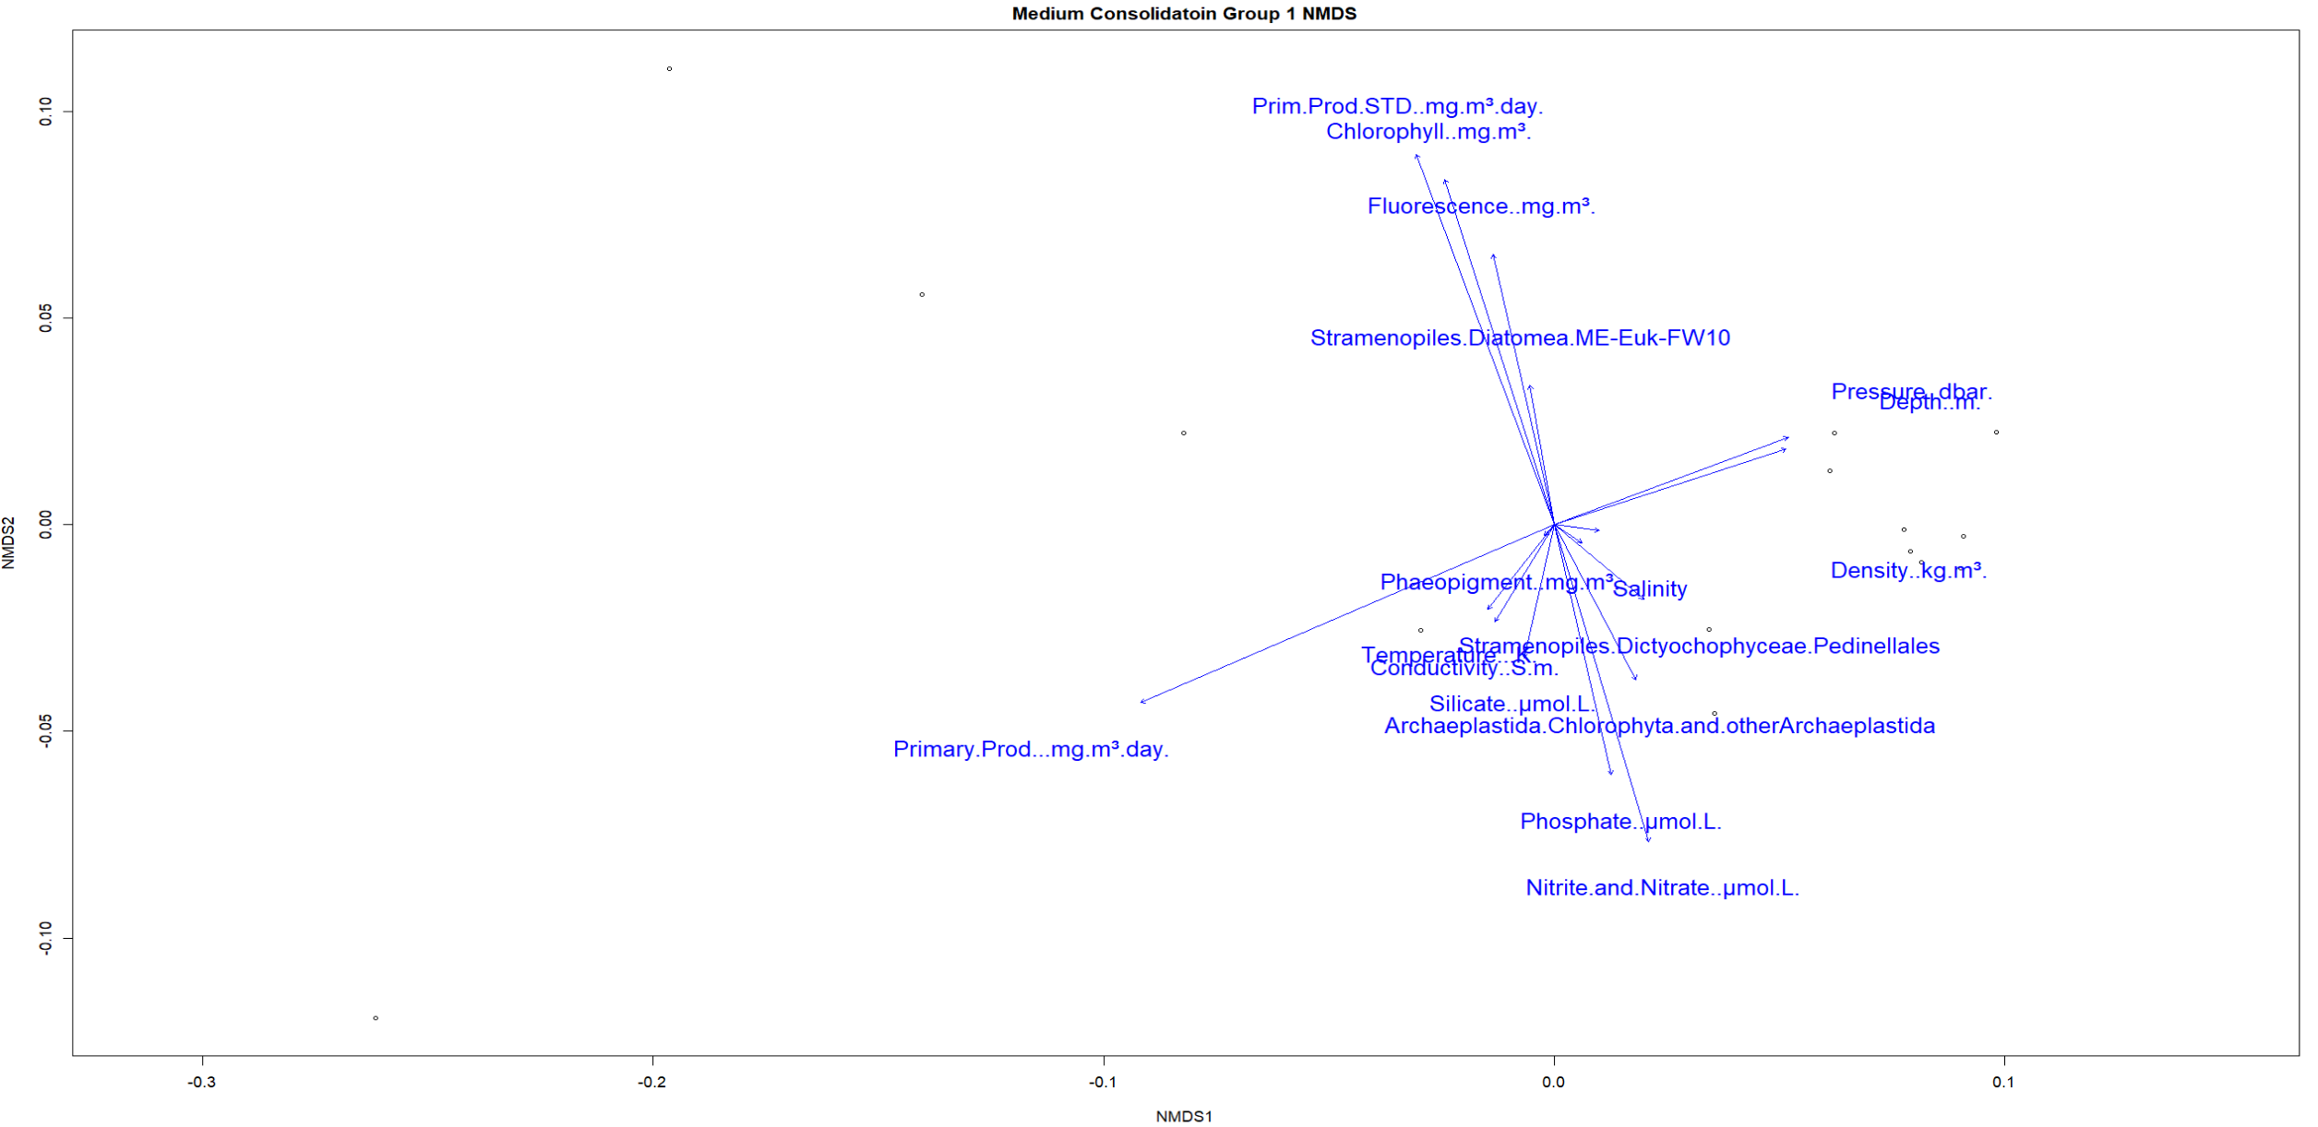

Slide 36
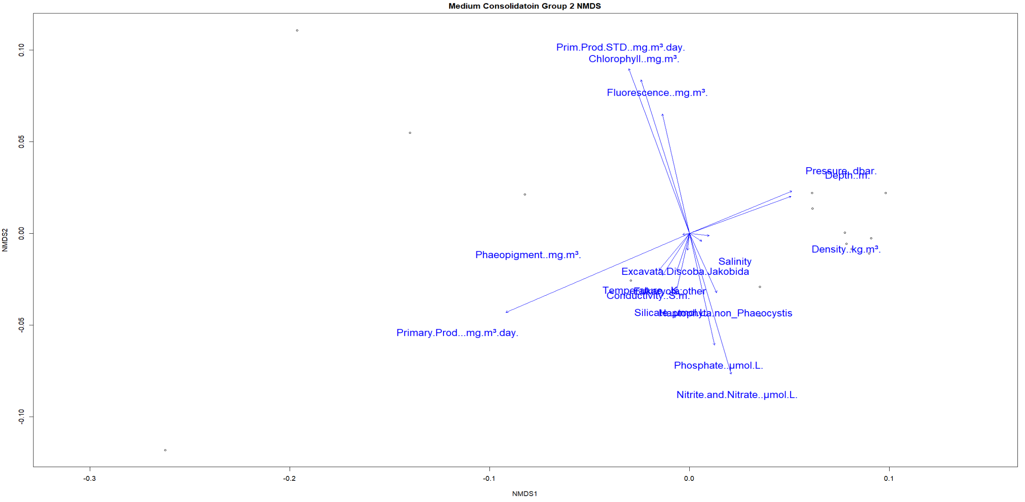

Slide 37
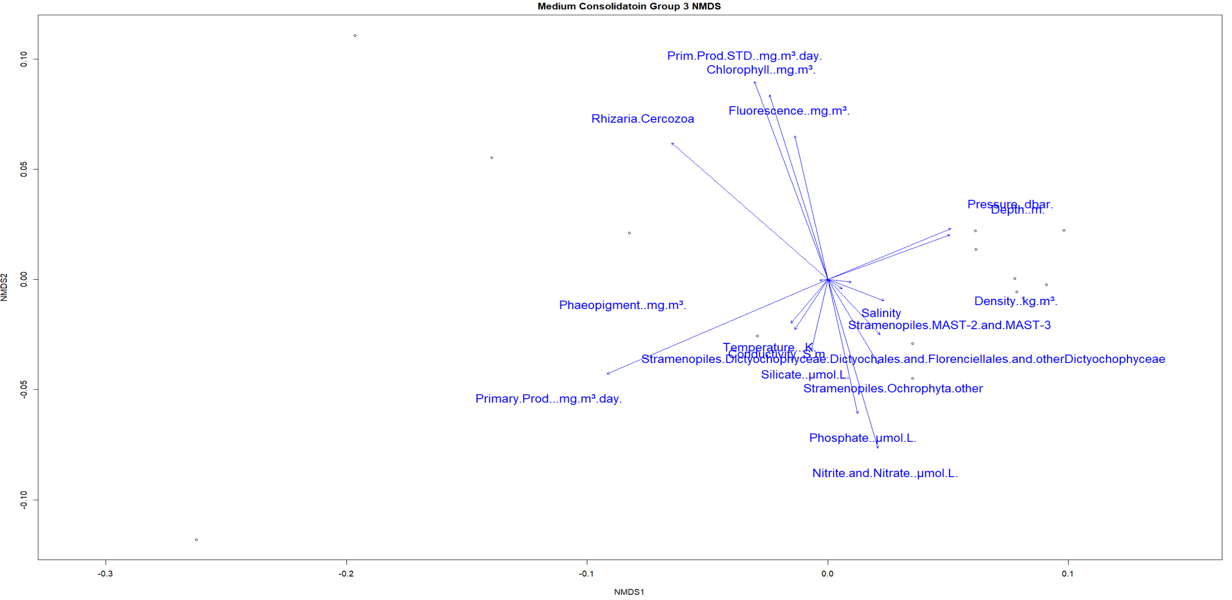

Slide 38
